Slide 1
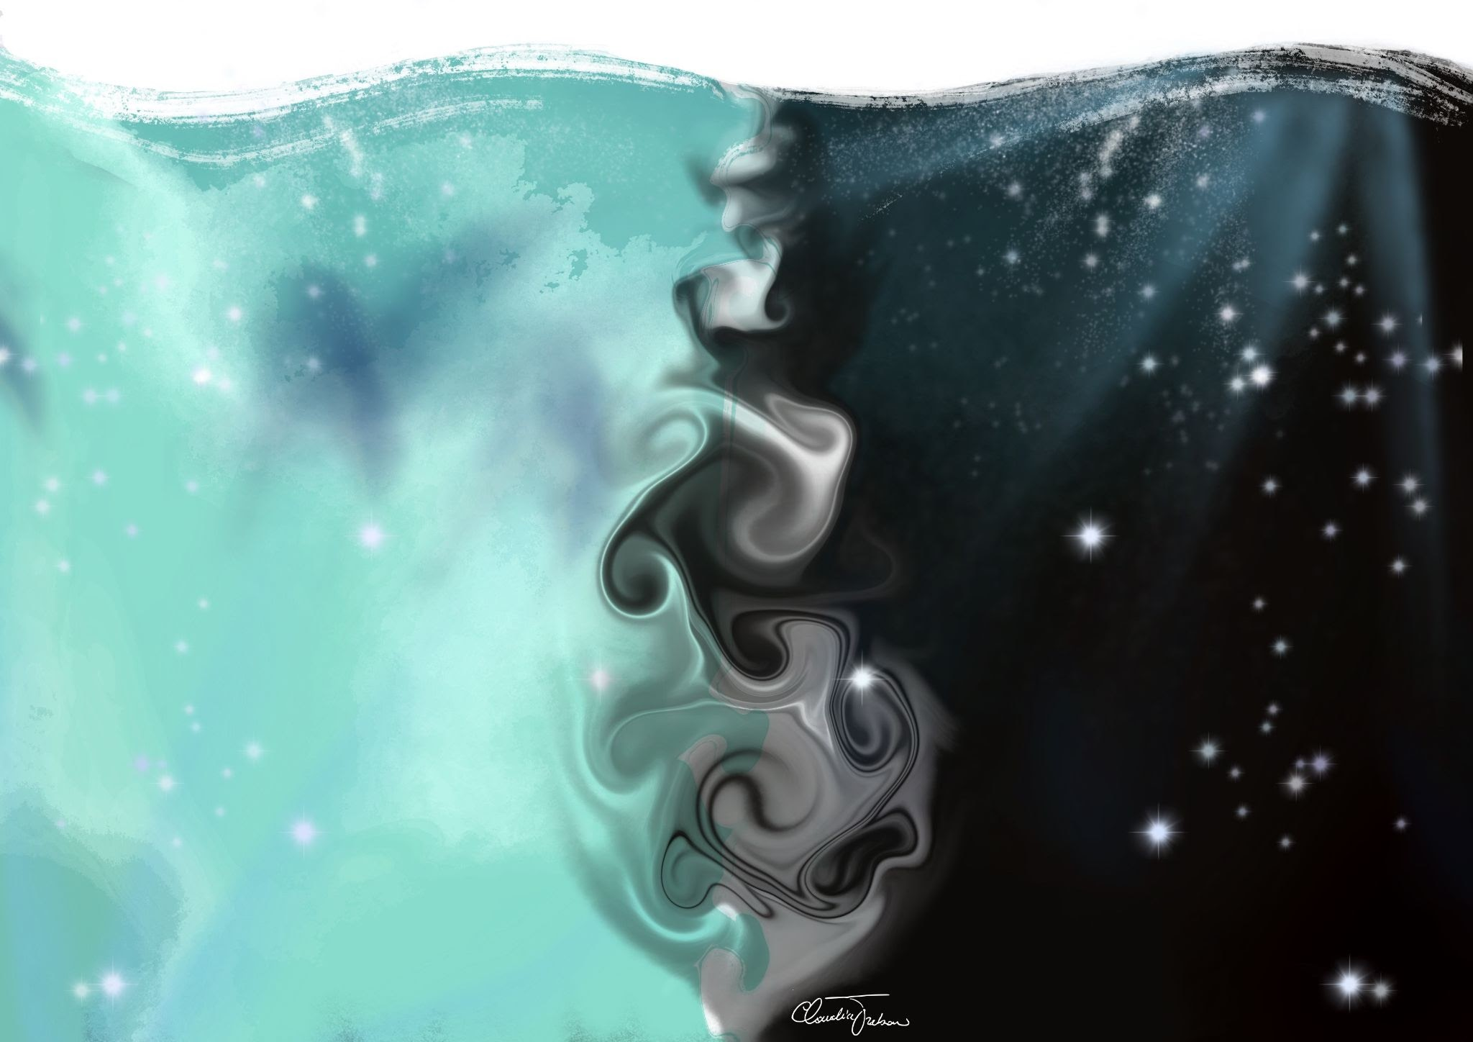
Session 1:
How do oceans move?
Created by:
*Ocean scientists*
USC postdocs
Brittany Bennett
Holland Elder
Jake Weissman
Jesse McNichol
Nicole Ratib
Suzana Leles
Trang Nguyen
In collaboration with:
LA public libraries & NeiSci
Art: Claudia Traboni
@ocean_sci_art
Notes:
Today we will explore how oceans move! We prepared three fun experiments to investigate this question. You will need your hands-out for today and the paper bag that has an yellow sticker and the number 1 on it. Something very important about this activity is that we will need cold and warm water. Make sure you are careful to not drop water on your device! Also, ask someone to heat water for you – do not do it yourself, be careful! We will now divide ourselves in breakout-rooms to do the experiments. We will have a cool scientist in each breakout room with you to guide you throughout the activity. After we all finish the experiments we will re-group here!

Slide 2
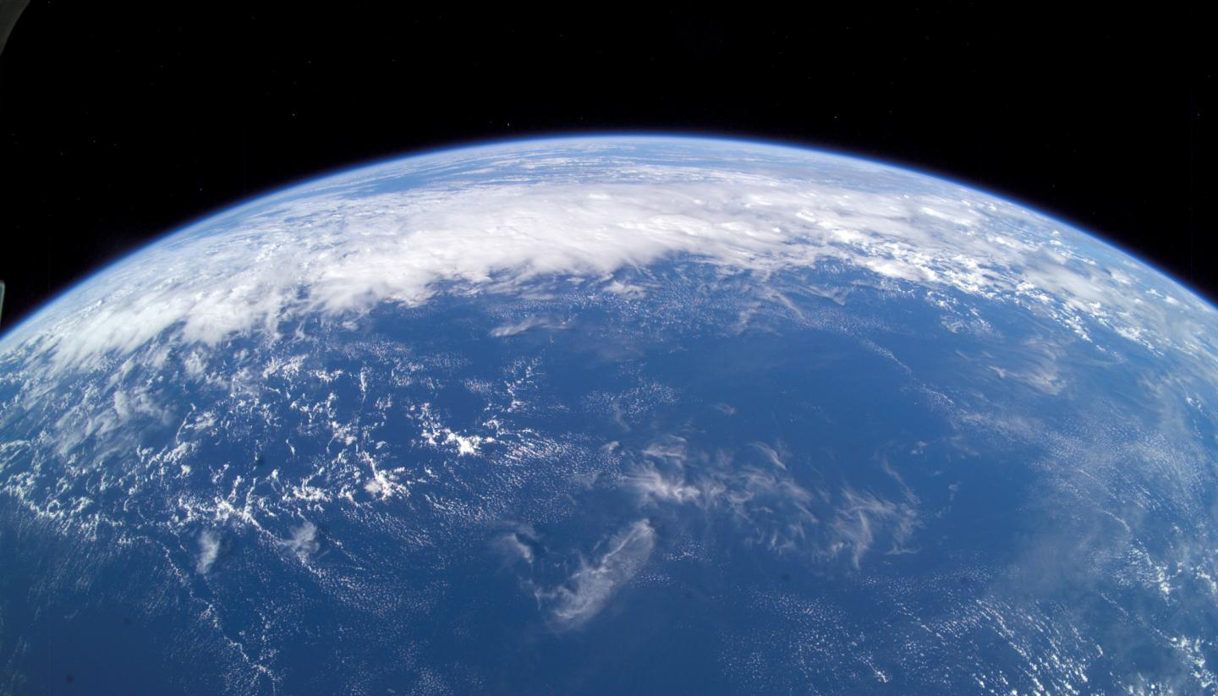
The ocean covers nearly 70% of the Earth’s surface
Credit: NASA
Notes:
Image: https://www.eurekalert.org/multimedia/684859
To show ocean circulation check “Perpetual ocean” from NASA: https://www.youtube.com/watch?v=CCmTY0PKGDs&t=2s

Slide 3
And this huge body of water is constantly moving
Check if Jesse could add a gif from “Perpetual ocean”: https://www.youtube.com/watch?v=CCmTY0PKGDs&t=2s
Credit: NASA
Credit: NASA “Perpetual Ocean”
Notes:
Gif from “Perpetual ocean” from NASA: https://www.youtube.com/watch?v=CCmTY0PKGDs&t=2s

Slide 4
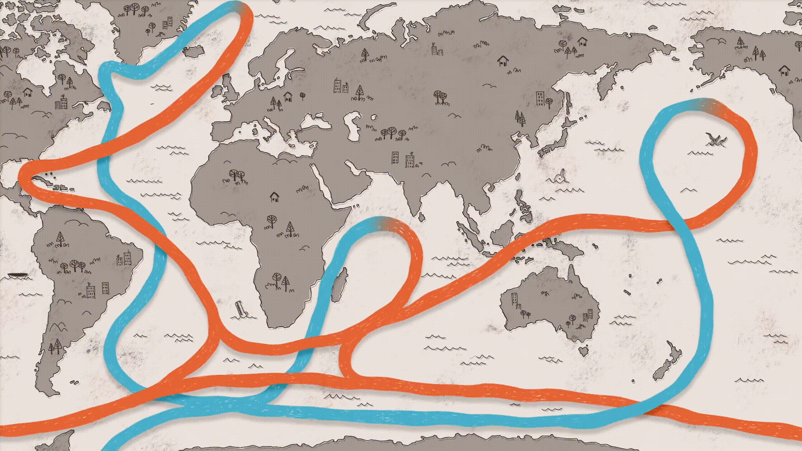
The powerful global ocean circulation
Credit: How do ocean currents work? - Jennifer Verduin - YouTube
Credit: NASA
Notes:
Gif: https://www.youtube.com/watch?v=p4pWafuvdrY

Slide 5
But what drives the powerful global ocean circulation?
Let’s perform some cool experiments together to discover this!
Credit: How do ocean currents work? - Jennifer Verduin - YouTube
Credit: NASA
Notes:
Gif: https://www.youtube.com/watch?v=p4pWafuvdrY

Slide 6
Experiment 1: saltwater versus freshwater
Food for thought:
Have you ever tried floating in a river and in the ocean?
Where do you think it would be easier to float?
To answer this, let’s think about the main differences between:
rivers/lakes and the ocean!

Slide 7
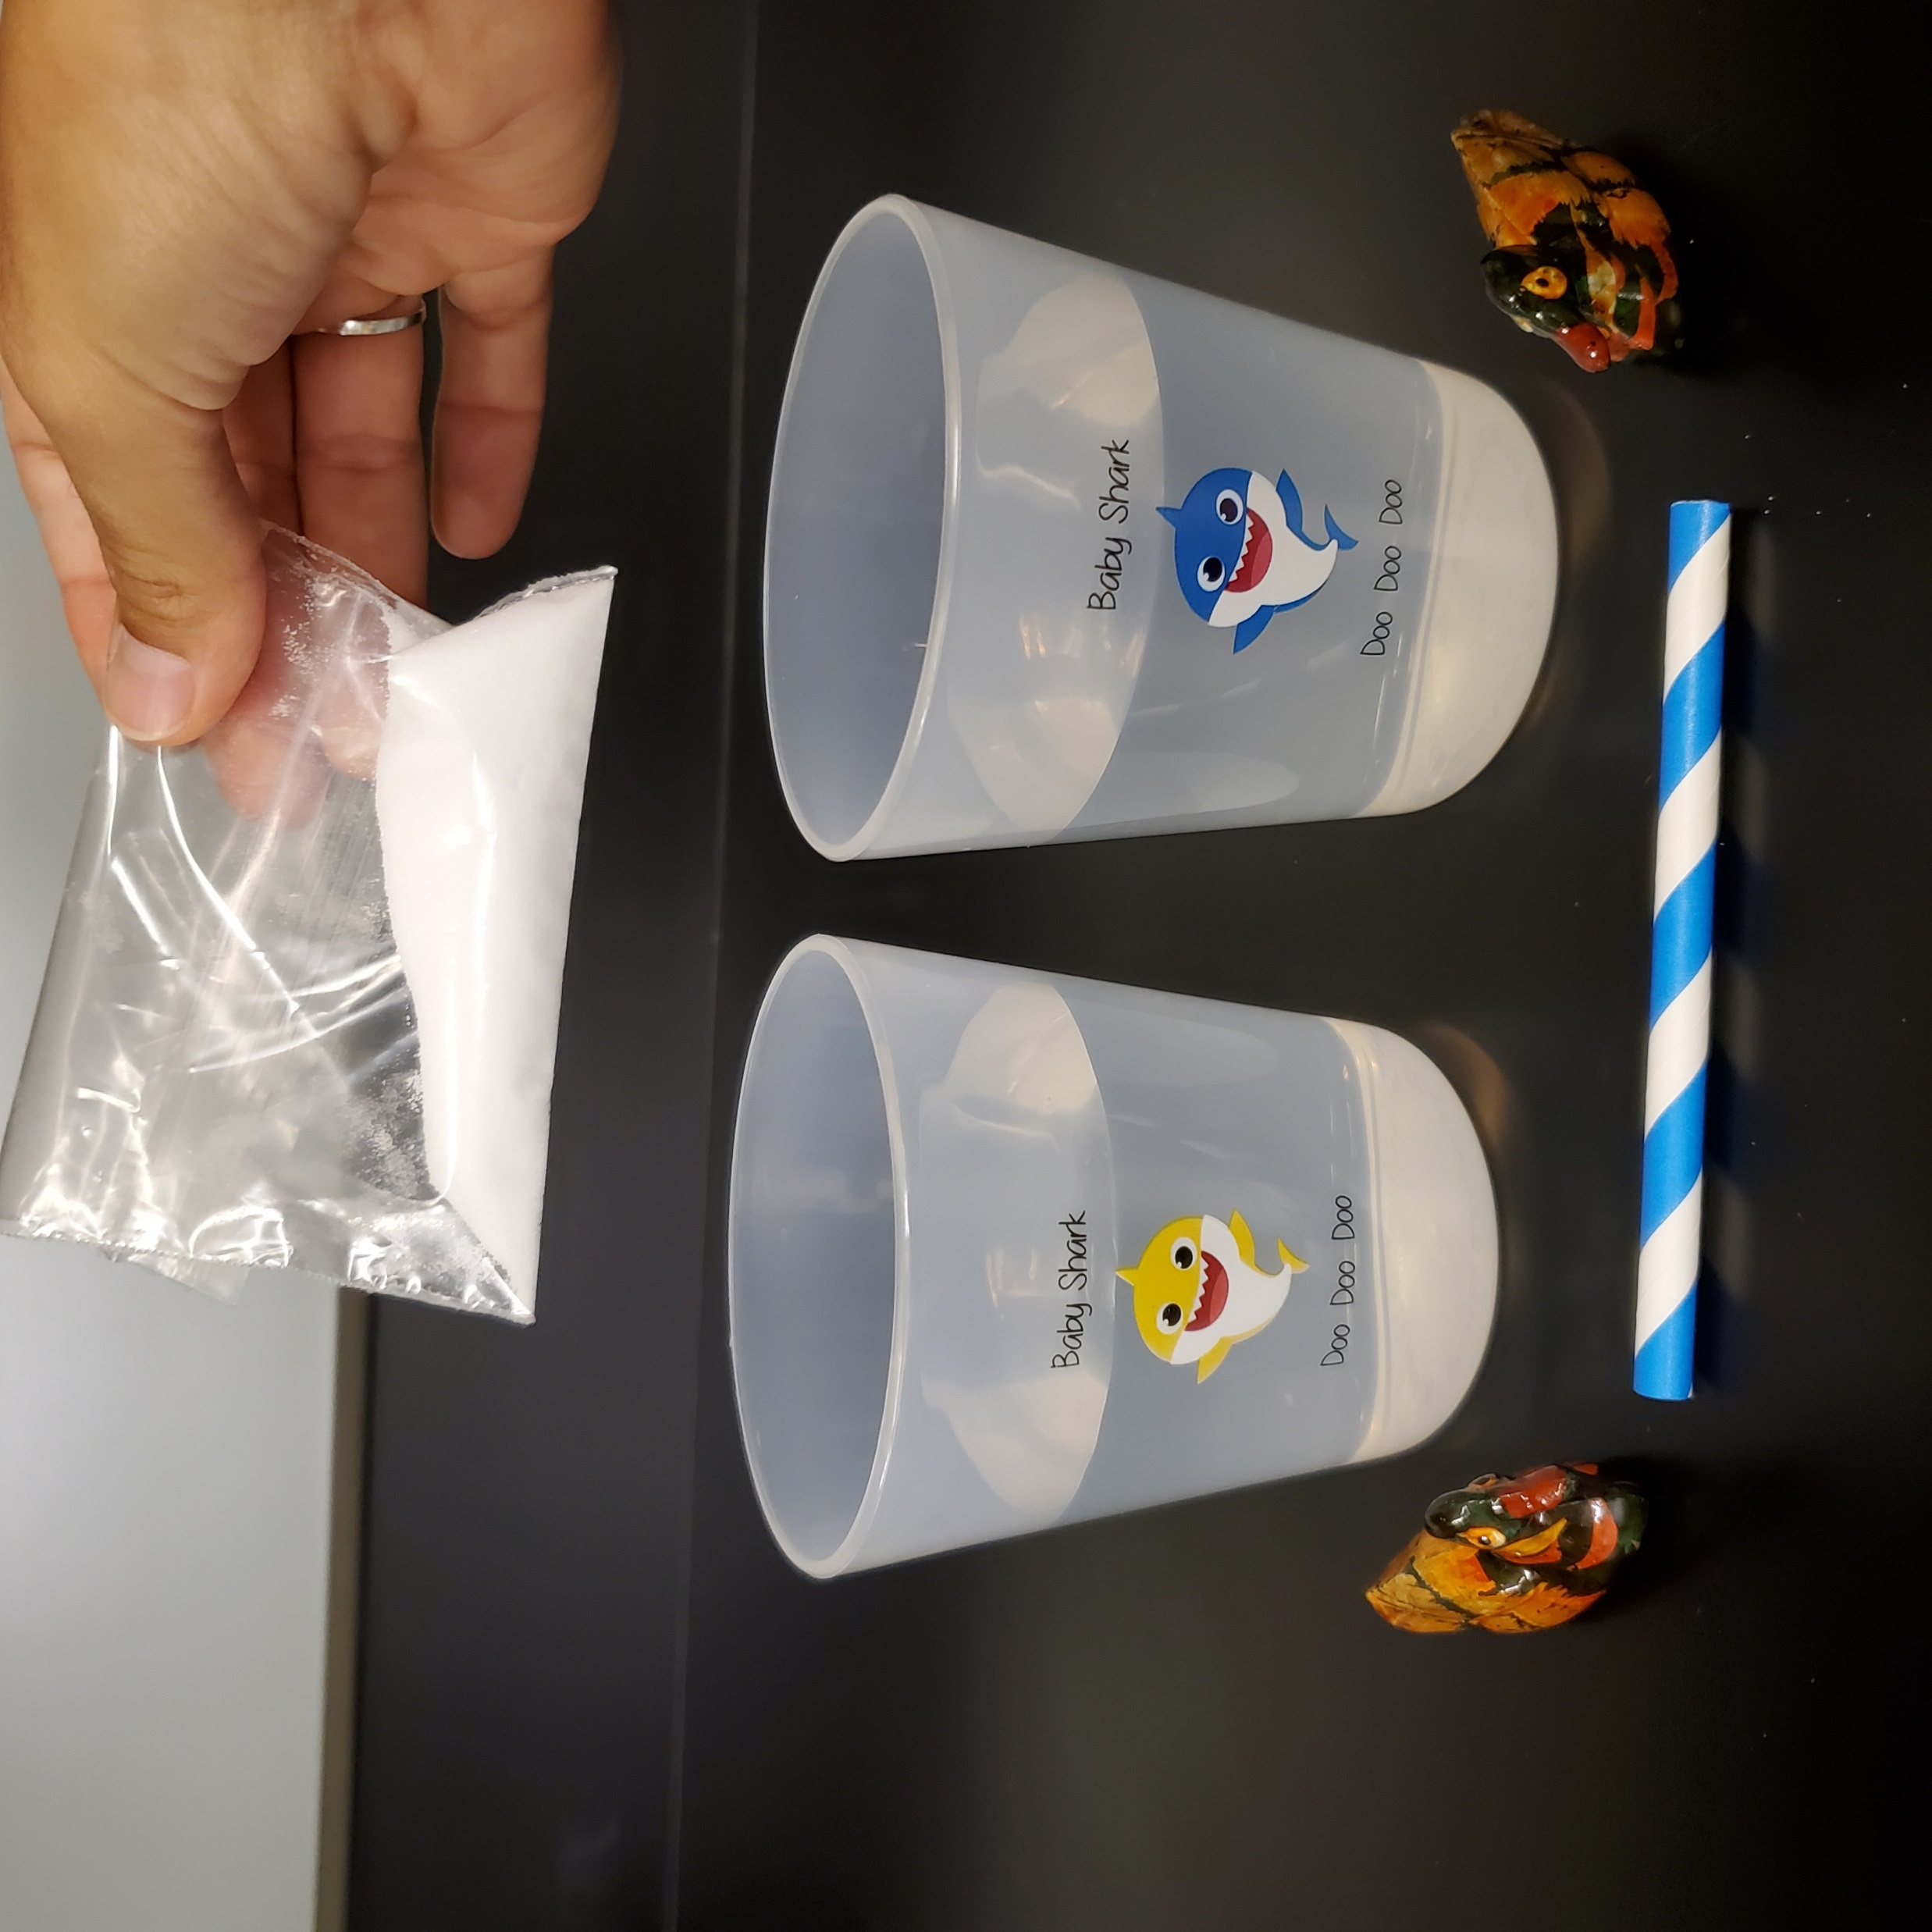
Experiment 1: saltwater versus freshwater
What you will need:
2 small ducks
2 plastic cups
Table salt
1 short paper straw
Tap water

Slide 8
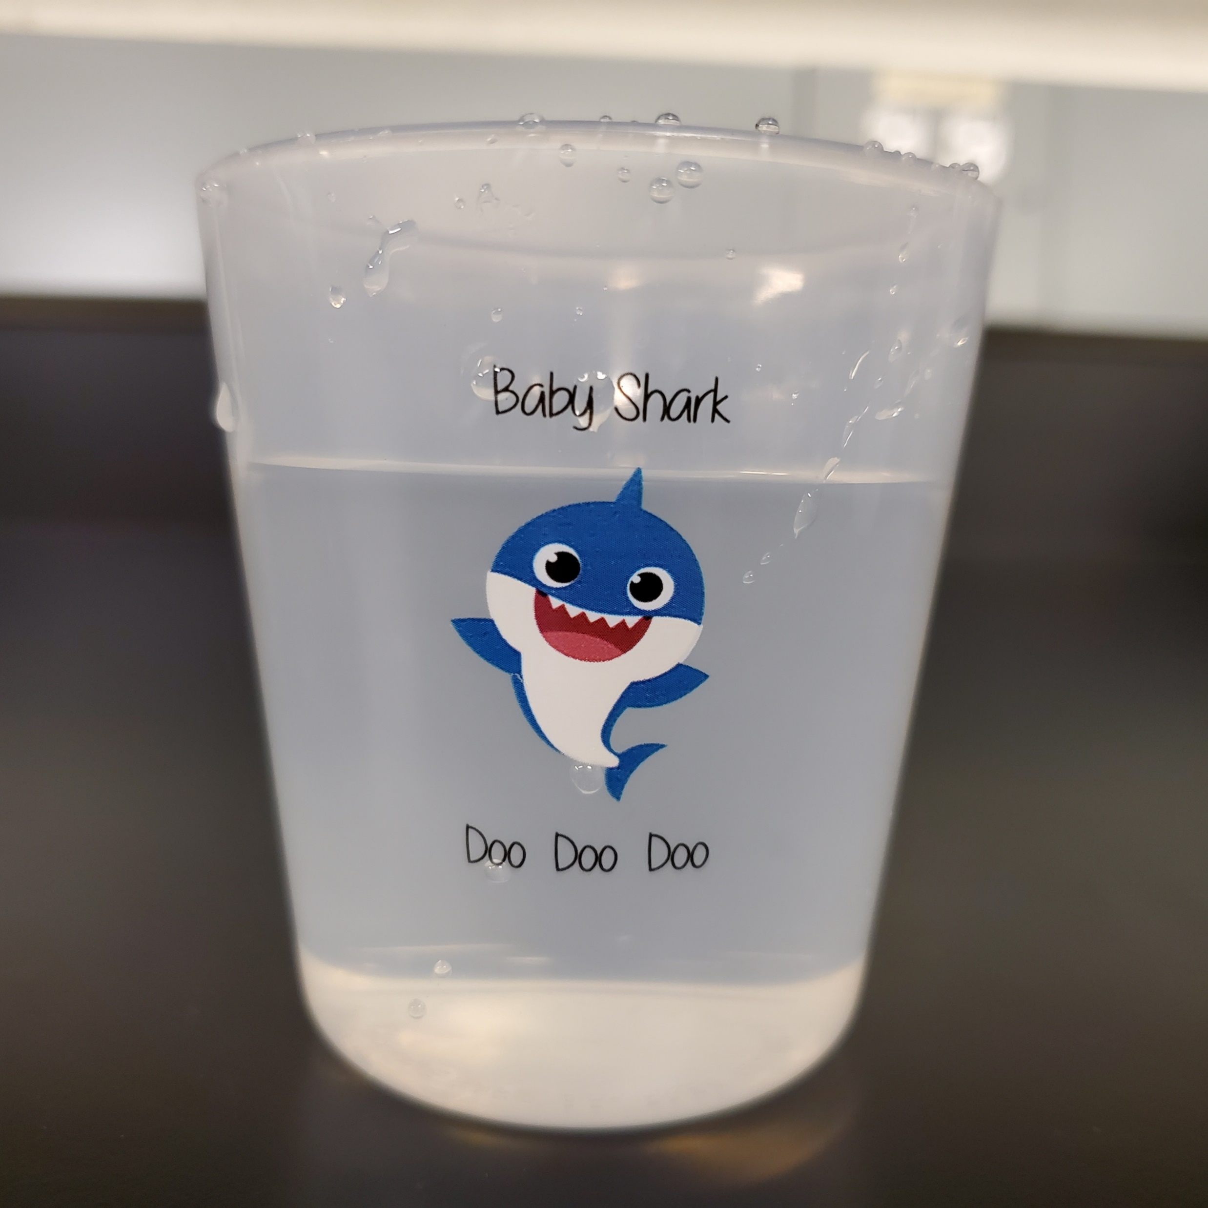
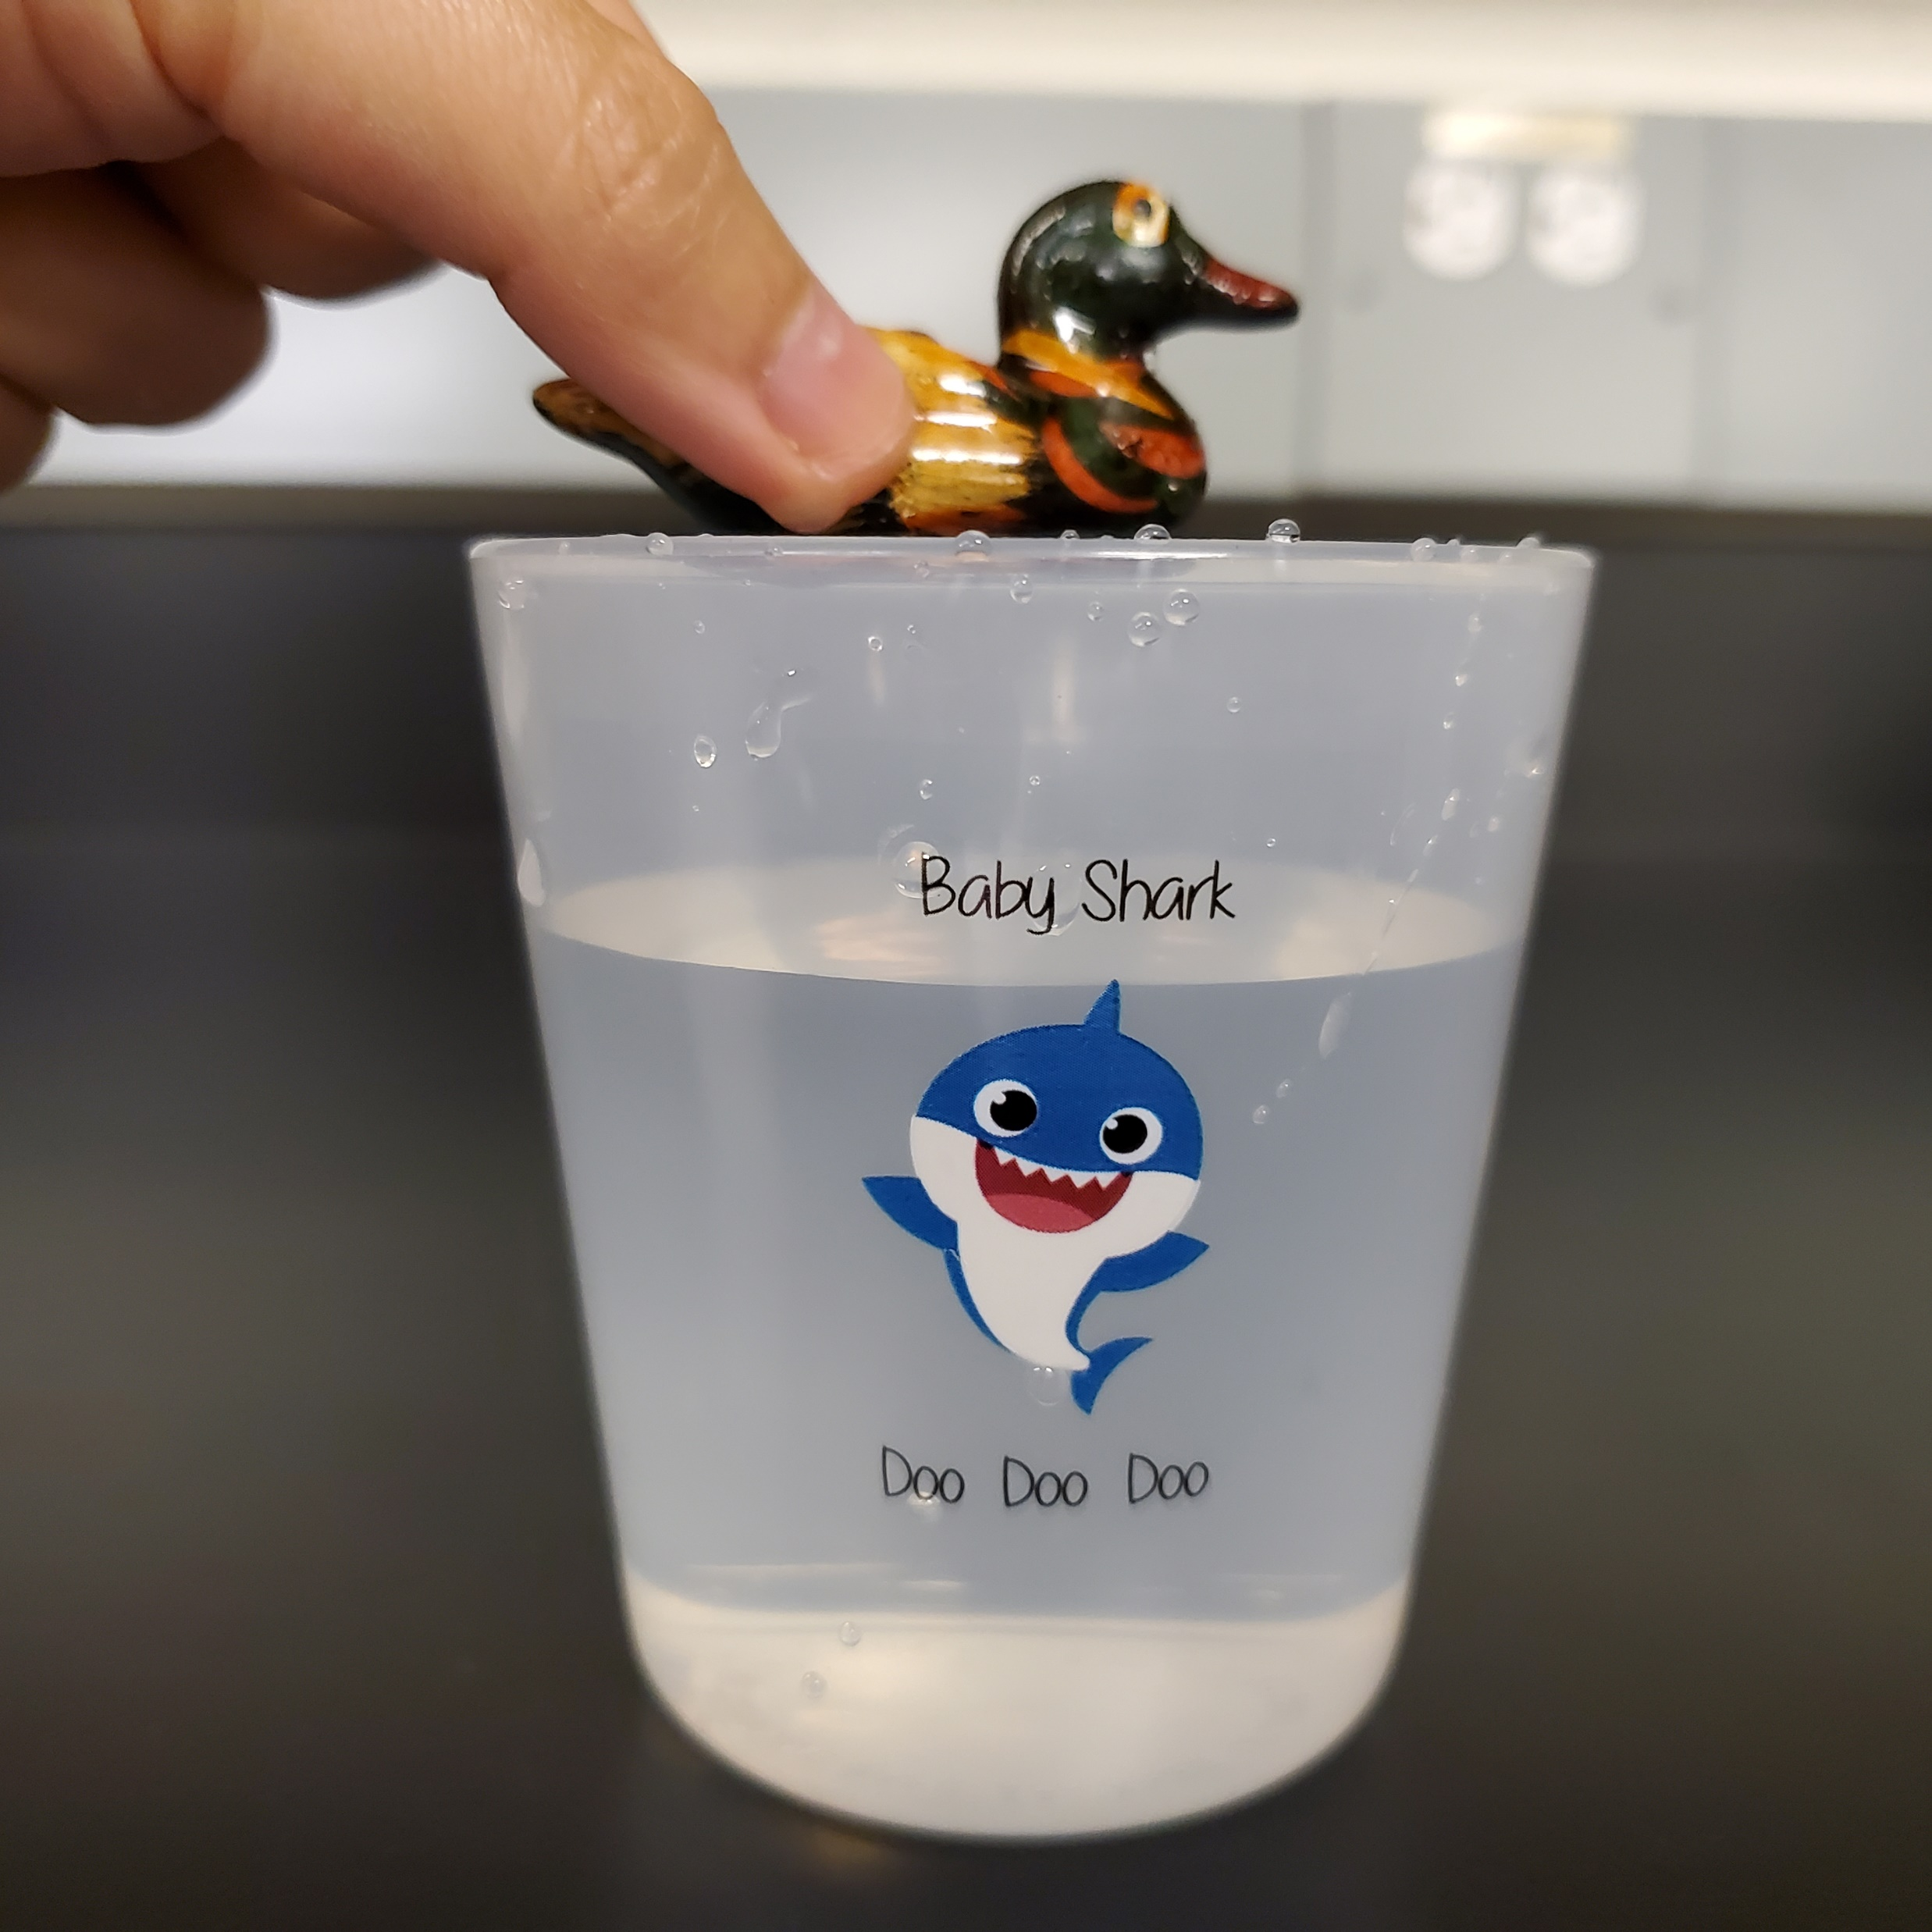
Experiment 1: saltwater versus freshwater
Step 1:
Fill one cup with
tap water.
Step 2:
Gently, place one of the ducks on top of the water surface and observe. What happens?

Slide 9
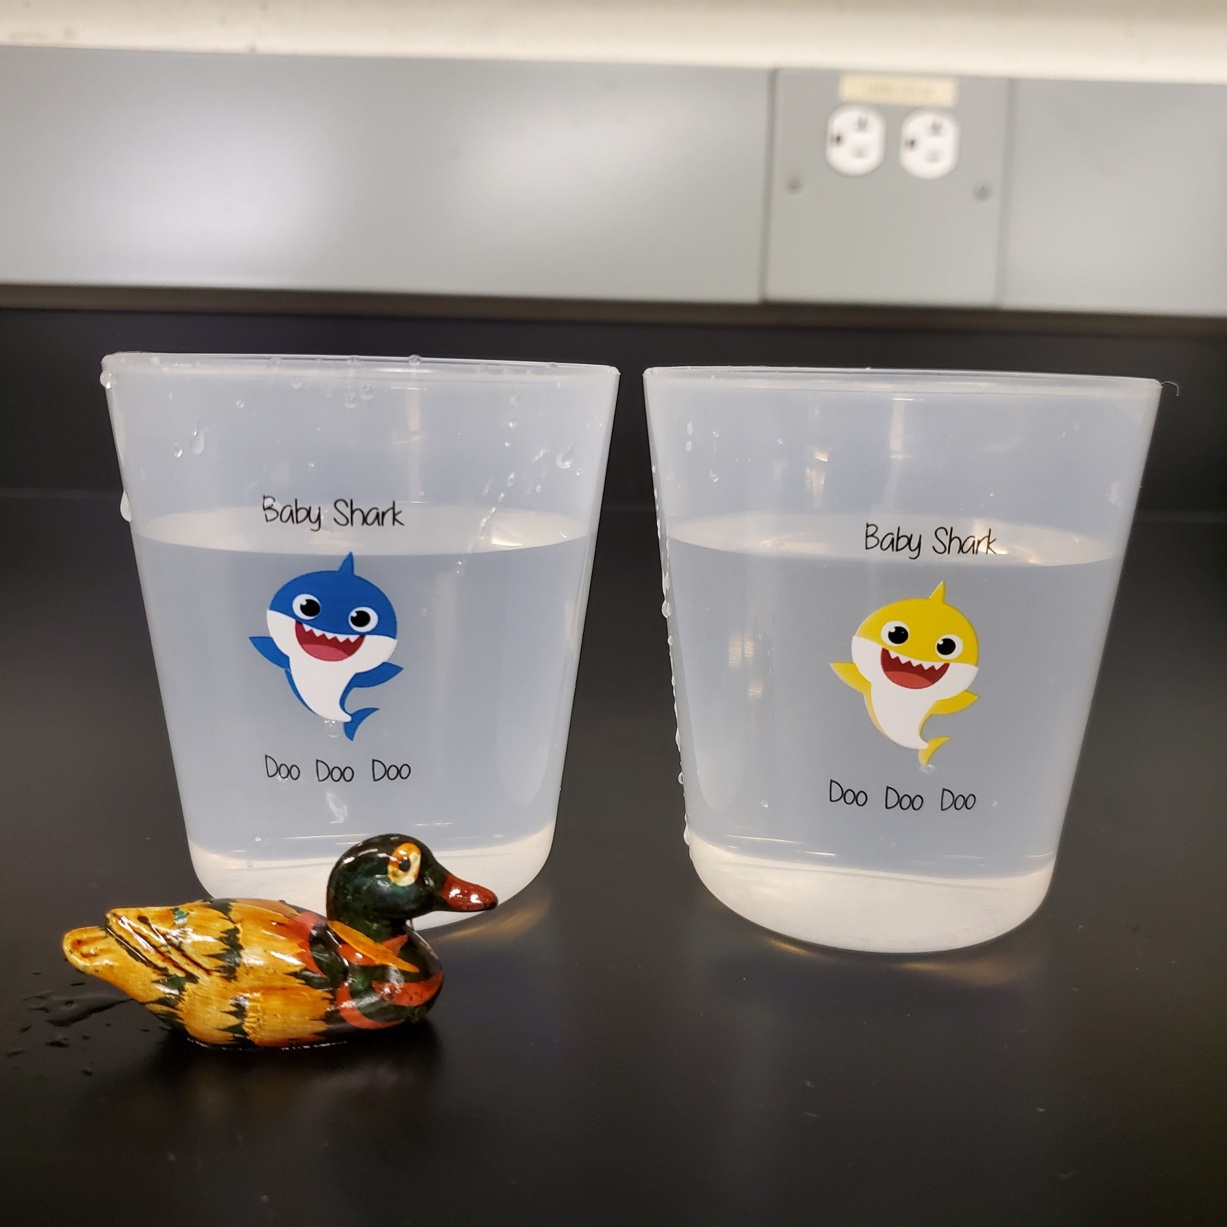
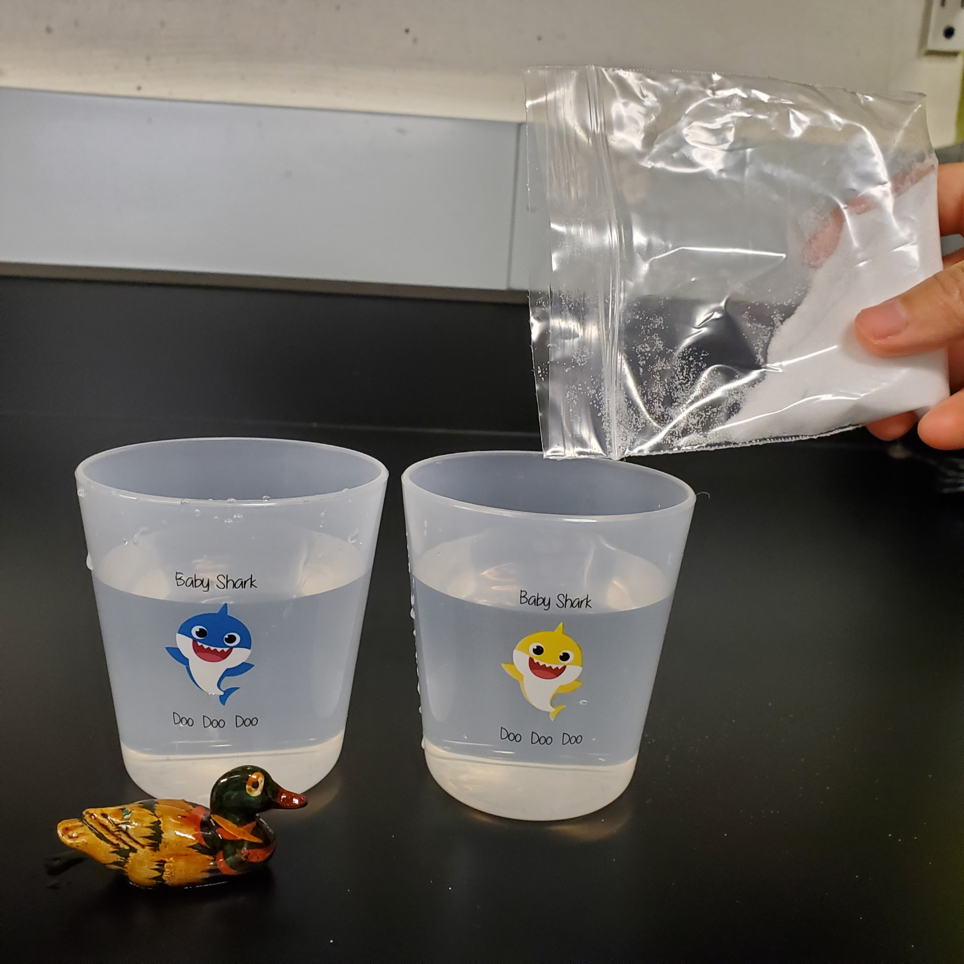
Experiment 1: saltwater versus freshwater
Step 3:
Fill the second cup with tap water.
Step 4:
Add the table salt to the second cup.

Slide 10
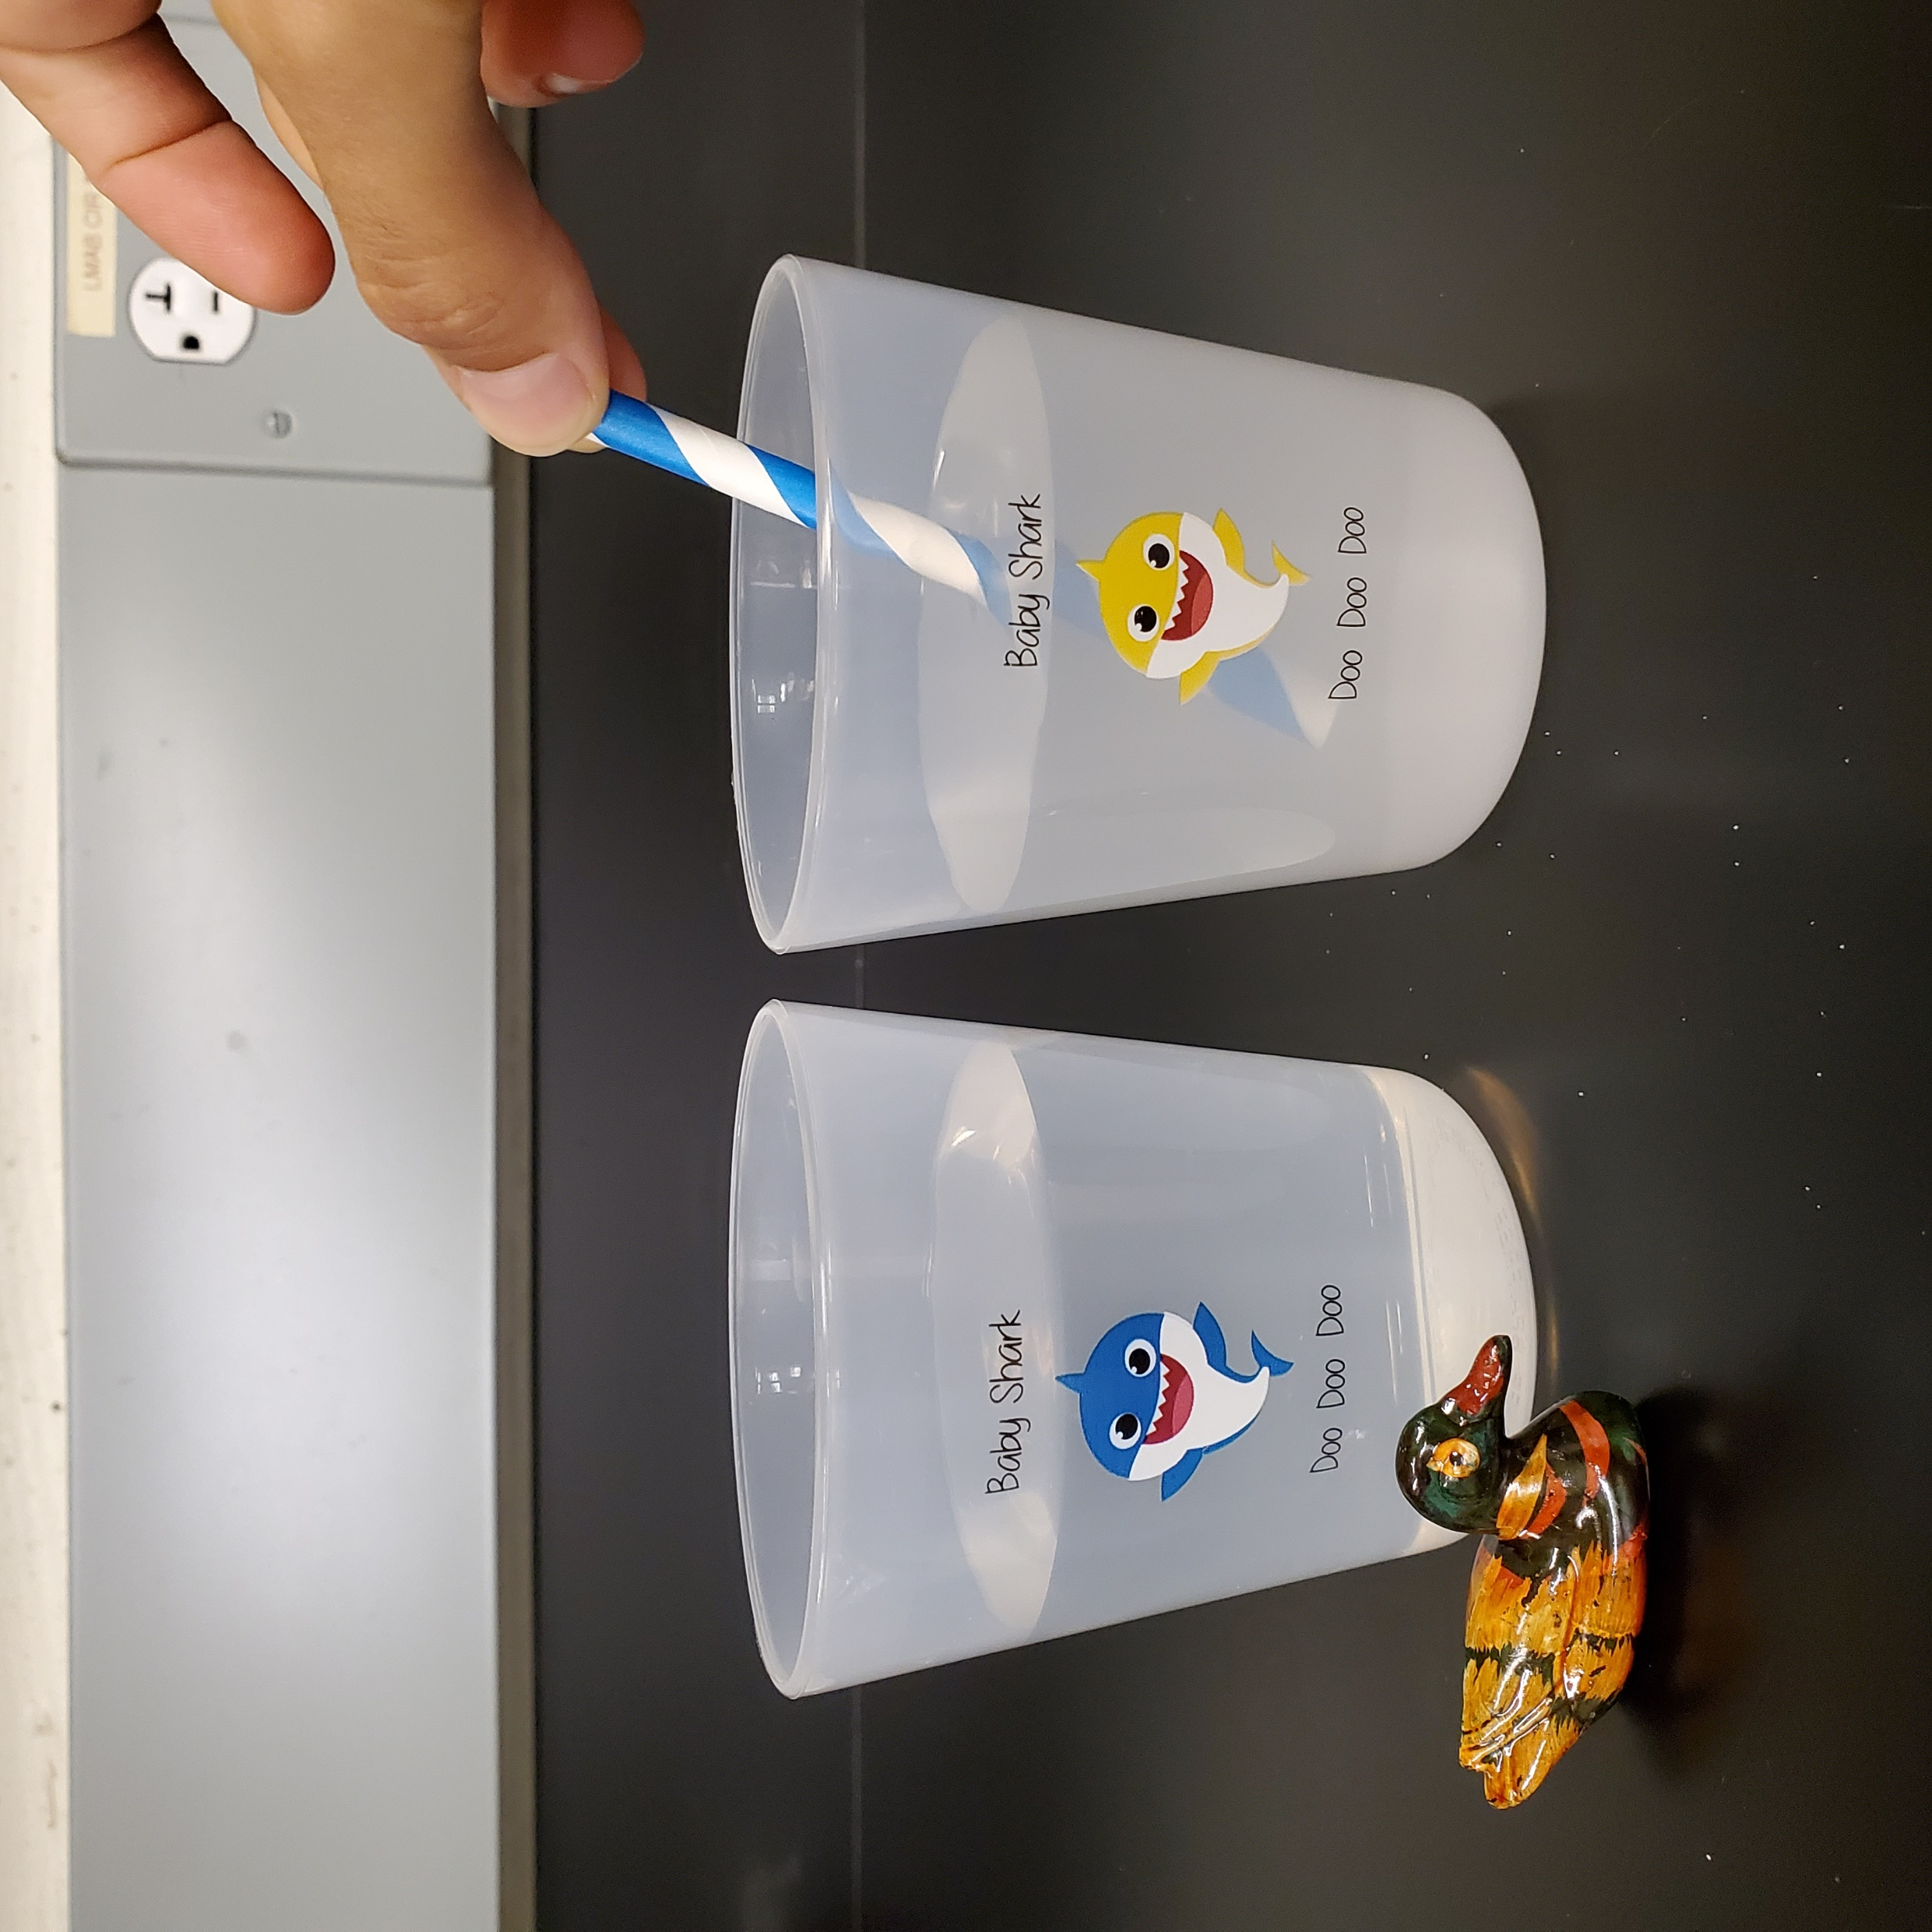
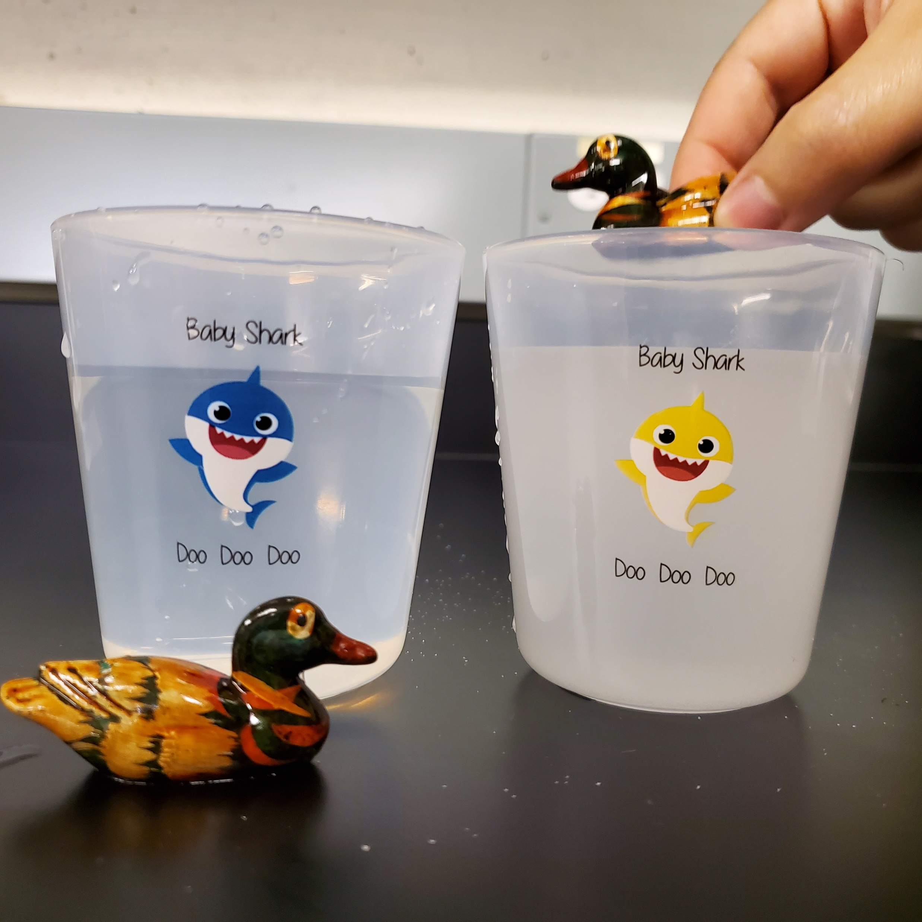
Experiment 1: saltwater versus freshwater
Step 5:
Stir it well with your short paper straw.
Step 6:
Gently, place the other duck on top of the water surface and observe. What happens?

Slide 11
Experiment 1: saltwater versus freshwater
What was our main finding?
We found that saltwater is heavier than freshwater!
Let’s keep this is mind and move to our next experiment
Notes:
How it works? As you place the ducks in cups with different waters (freshwater versus saltwater), you will learn that the saltwater is denser than the freshwater, since the ducks will float in one cup and sink in the other.
Gif: https://www.youtube.com/watch?v=p4pWafuvdrY

Slide 12
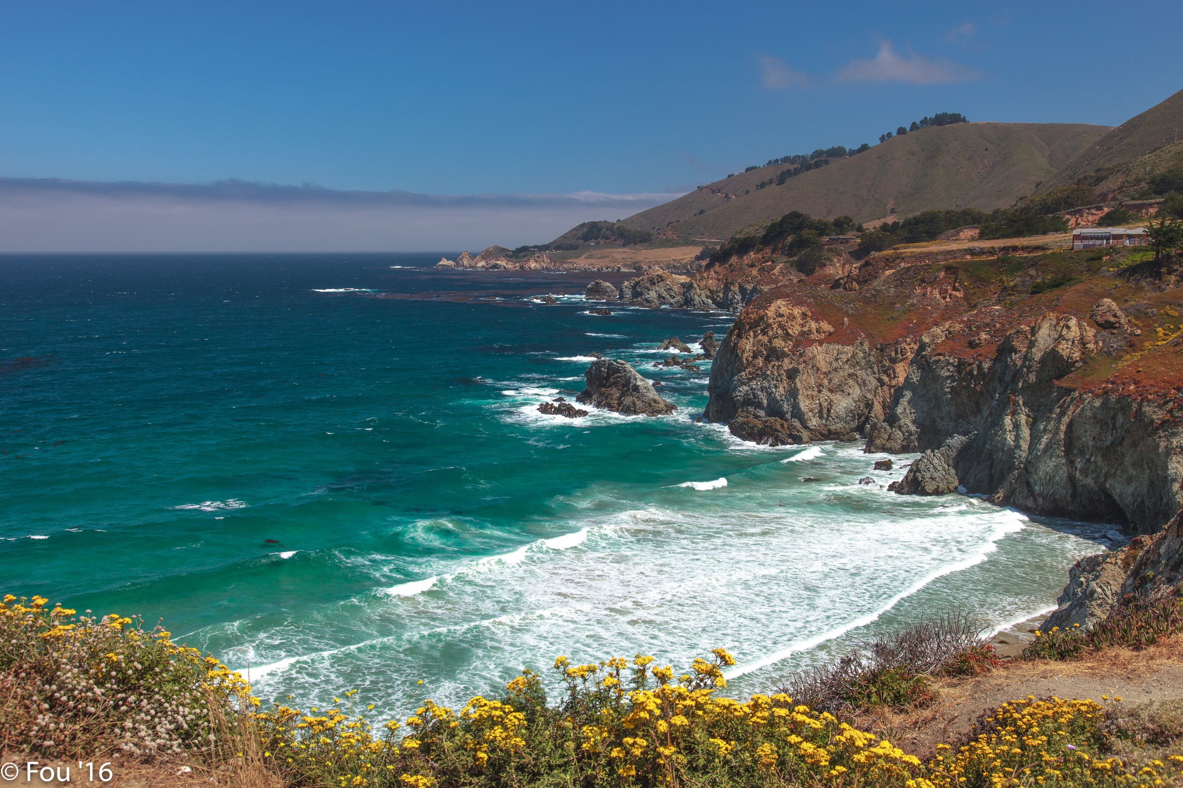
Experiment 2: cold water versus warm water
Food for thought:
What is the main difference between summer and winter?
What do you think will happen with the seawater?

Slide 13
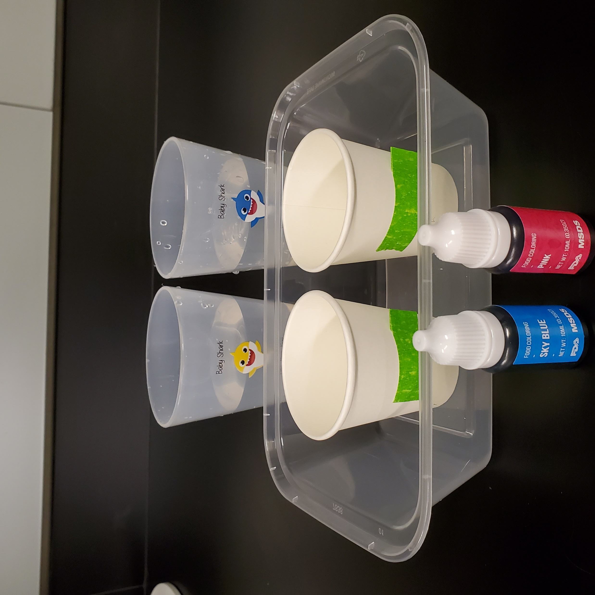
Experiment 2: cold water versus warm water
What you will need:
2 food coloring
2 paper cups
2 plastic cups
1 plastic tray
1 short paper straw
Cold & warm water

Slide 14
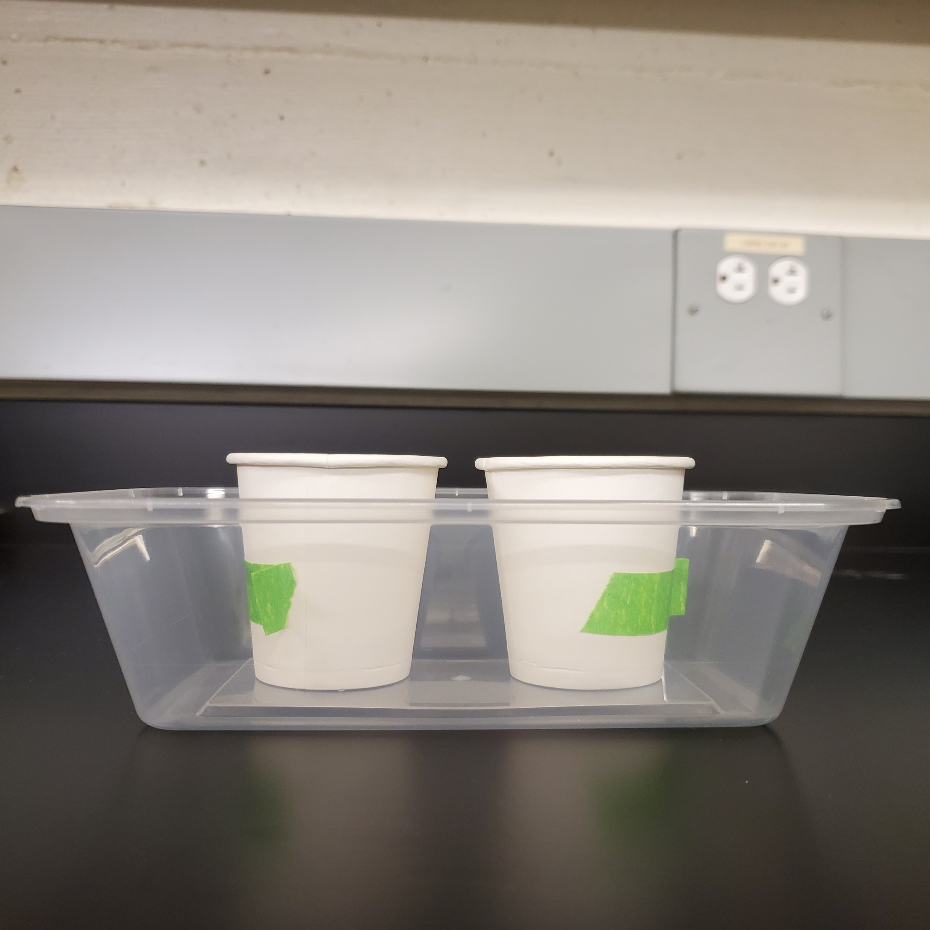
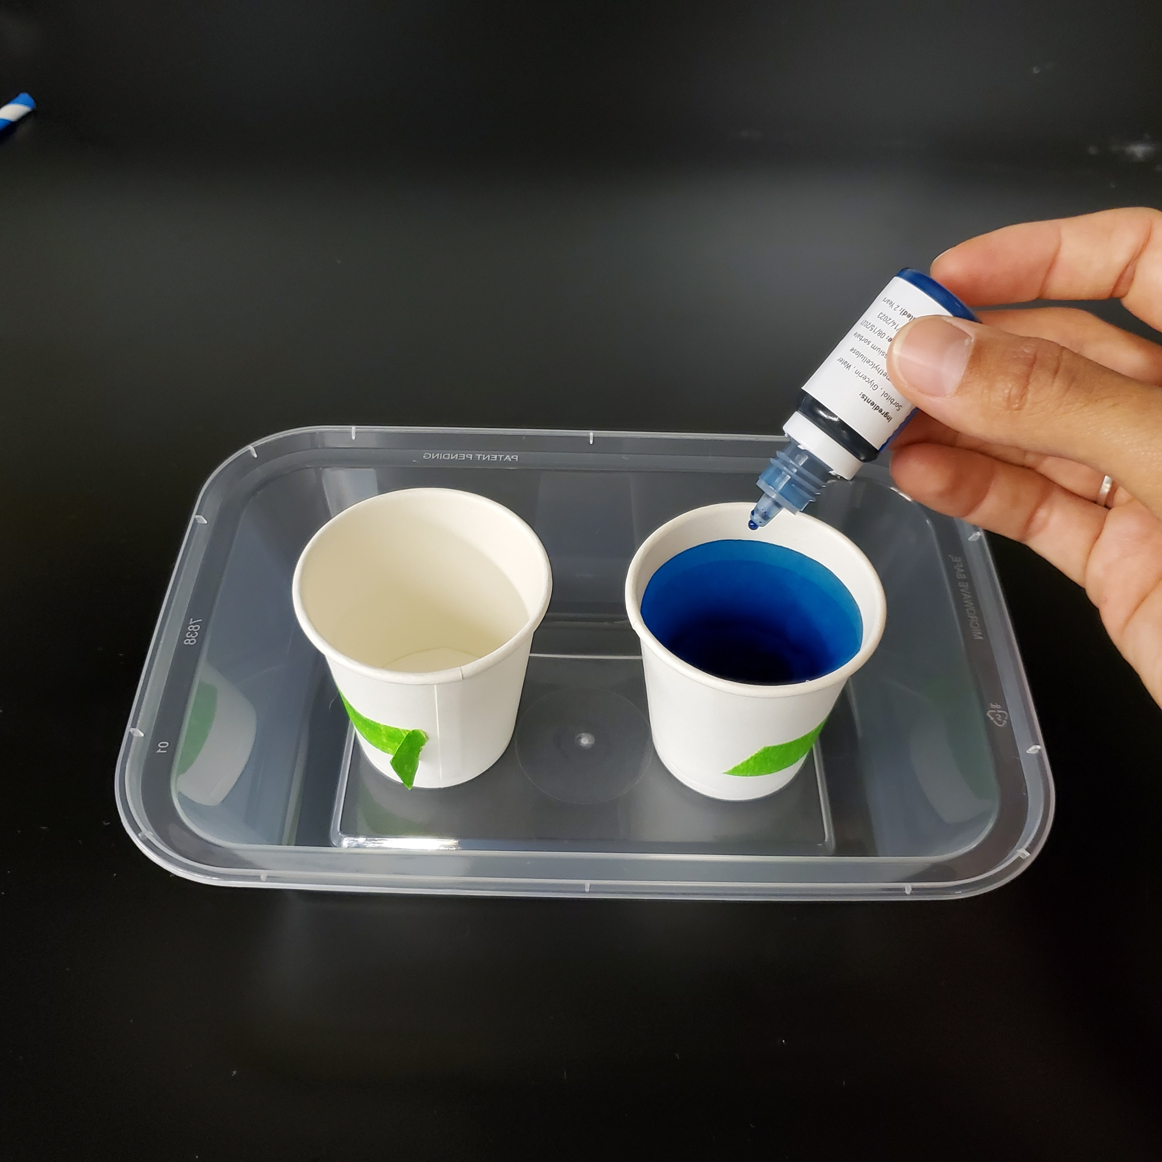
Experiment 2: cold water versus warm water
Step 1:
Put the paper cups inside the tray, With the tapes facing sideways.
Step 2:
Add cold water to one of the paper cups + 6 drops of the cold food coloring and stir it well.

Slide 15
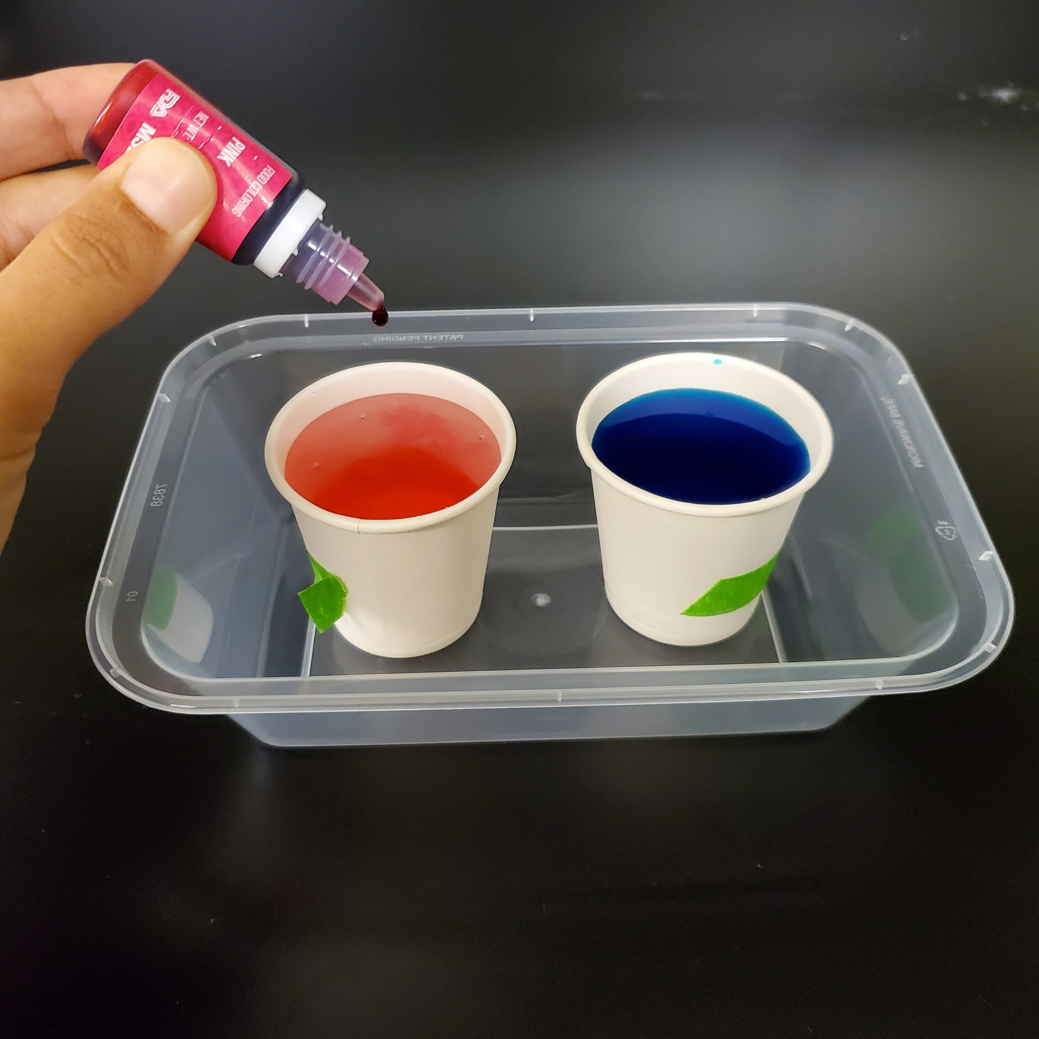
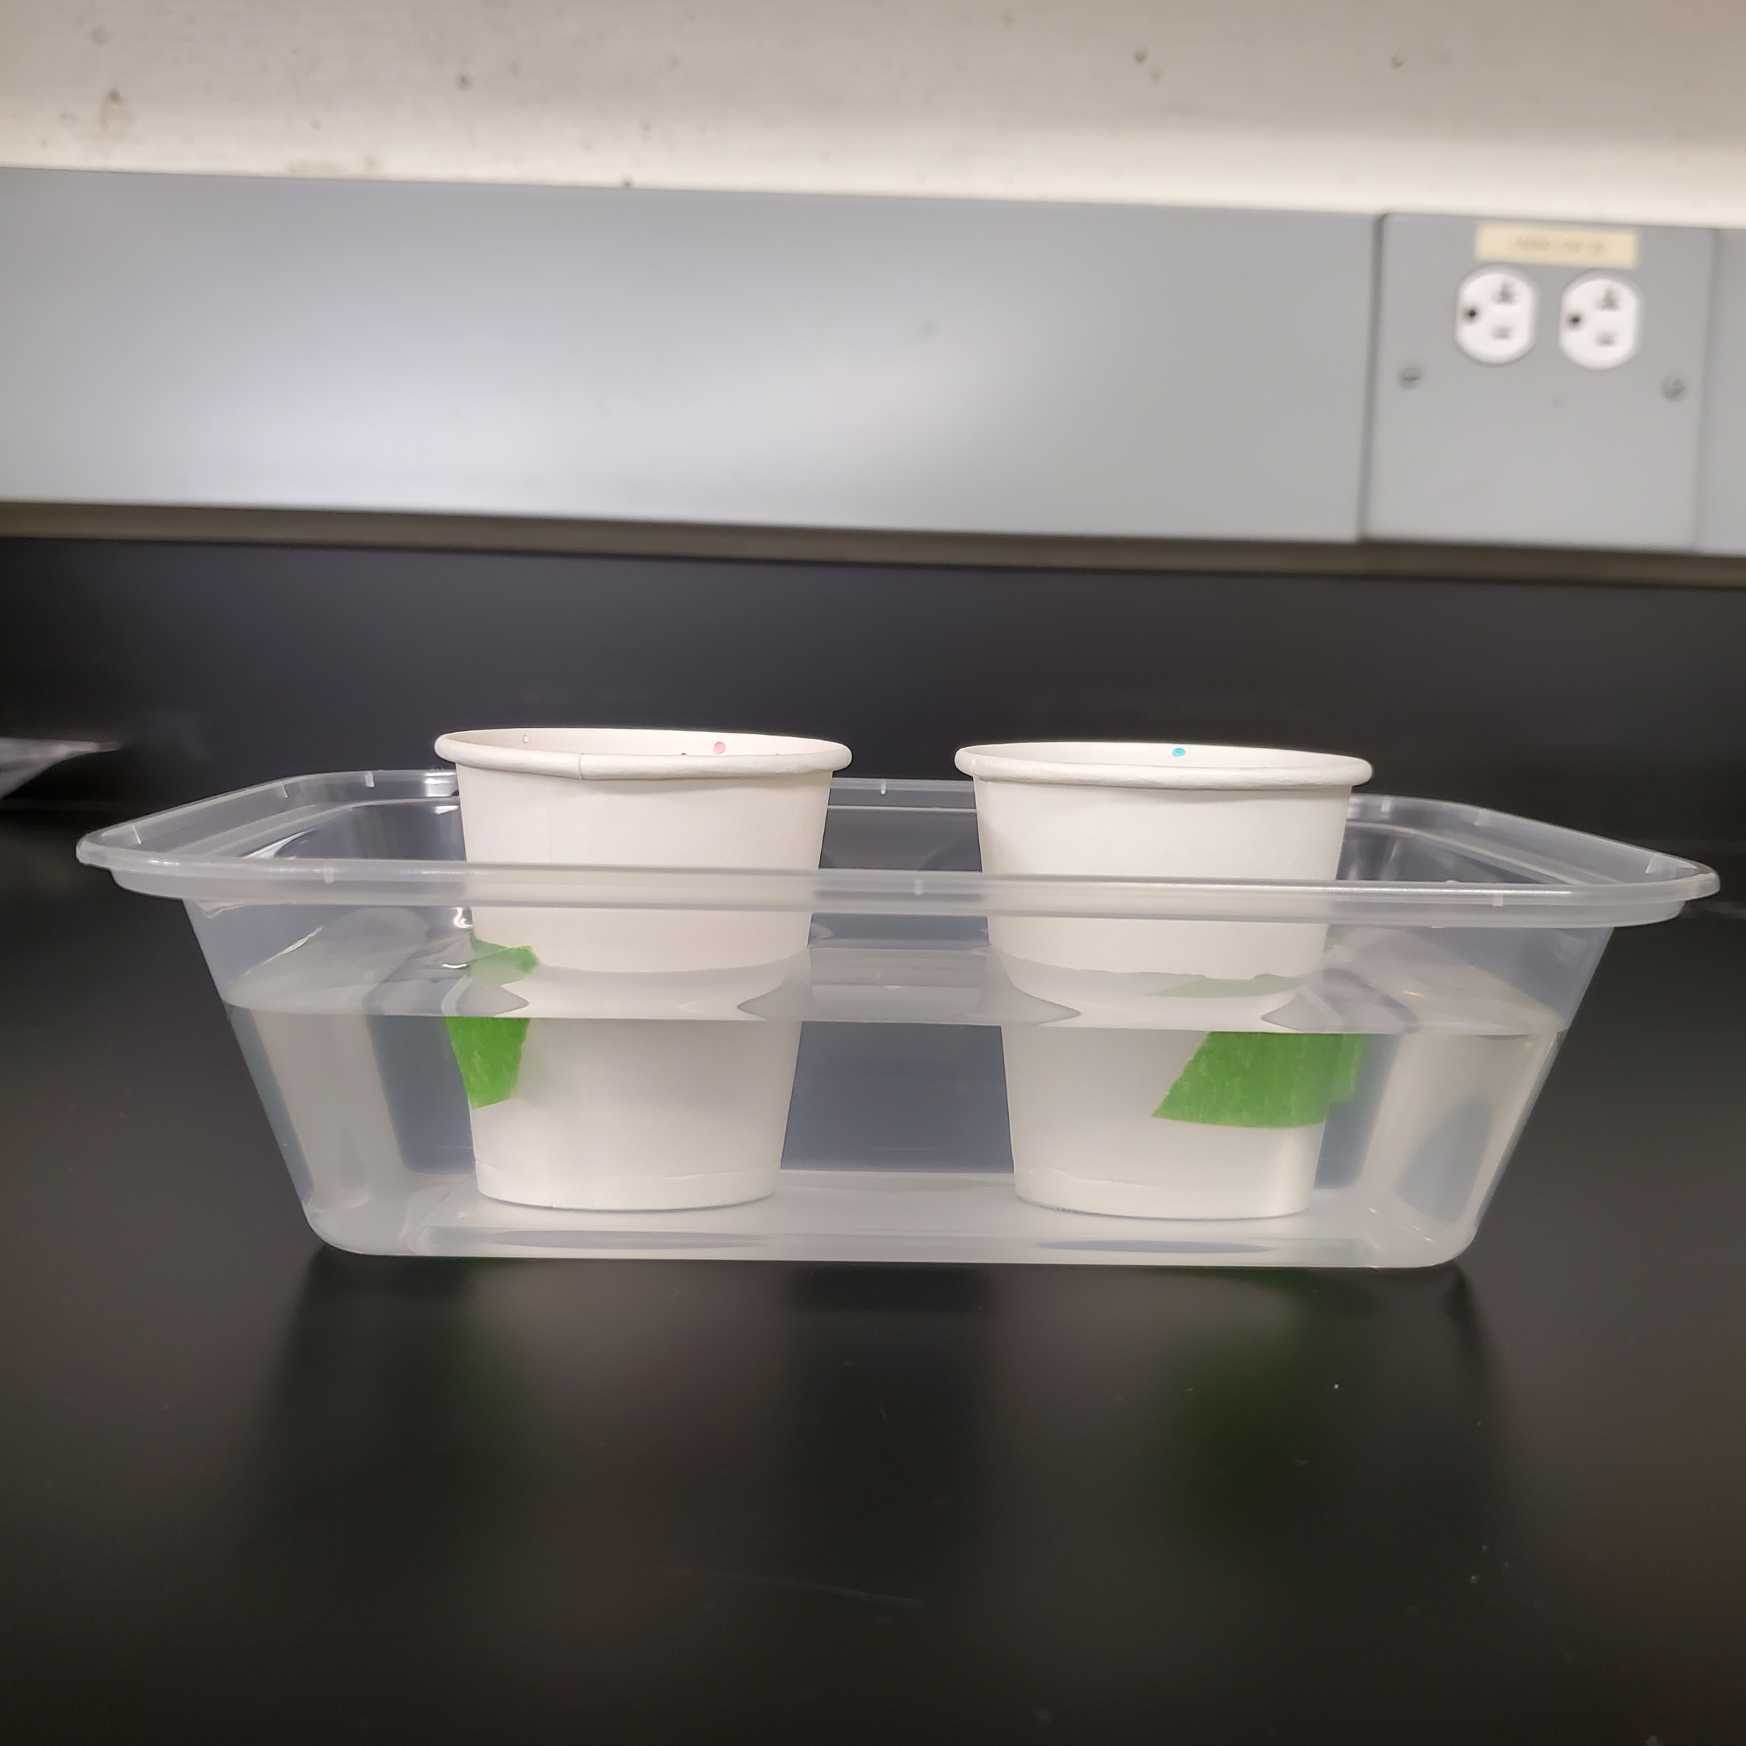
Experiment 2: cold water versus warm water
Step 3:
Add warm water to the other paper cup + 12 drops of the warm food coloring and stir it well.
Step 4:
Add tap water to the plastic tray until it is half full (make sure it does not surpass the level of water in the paper cups).

Slide 16
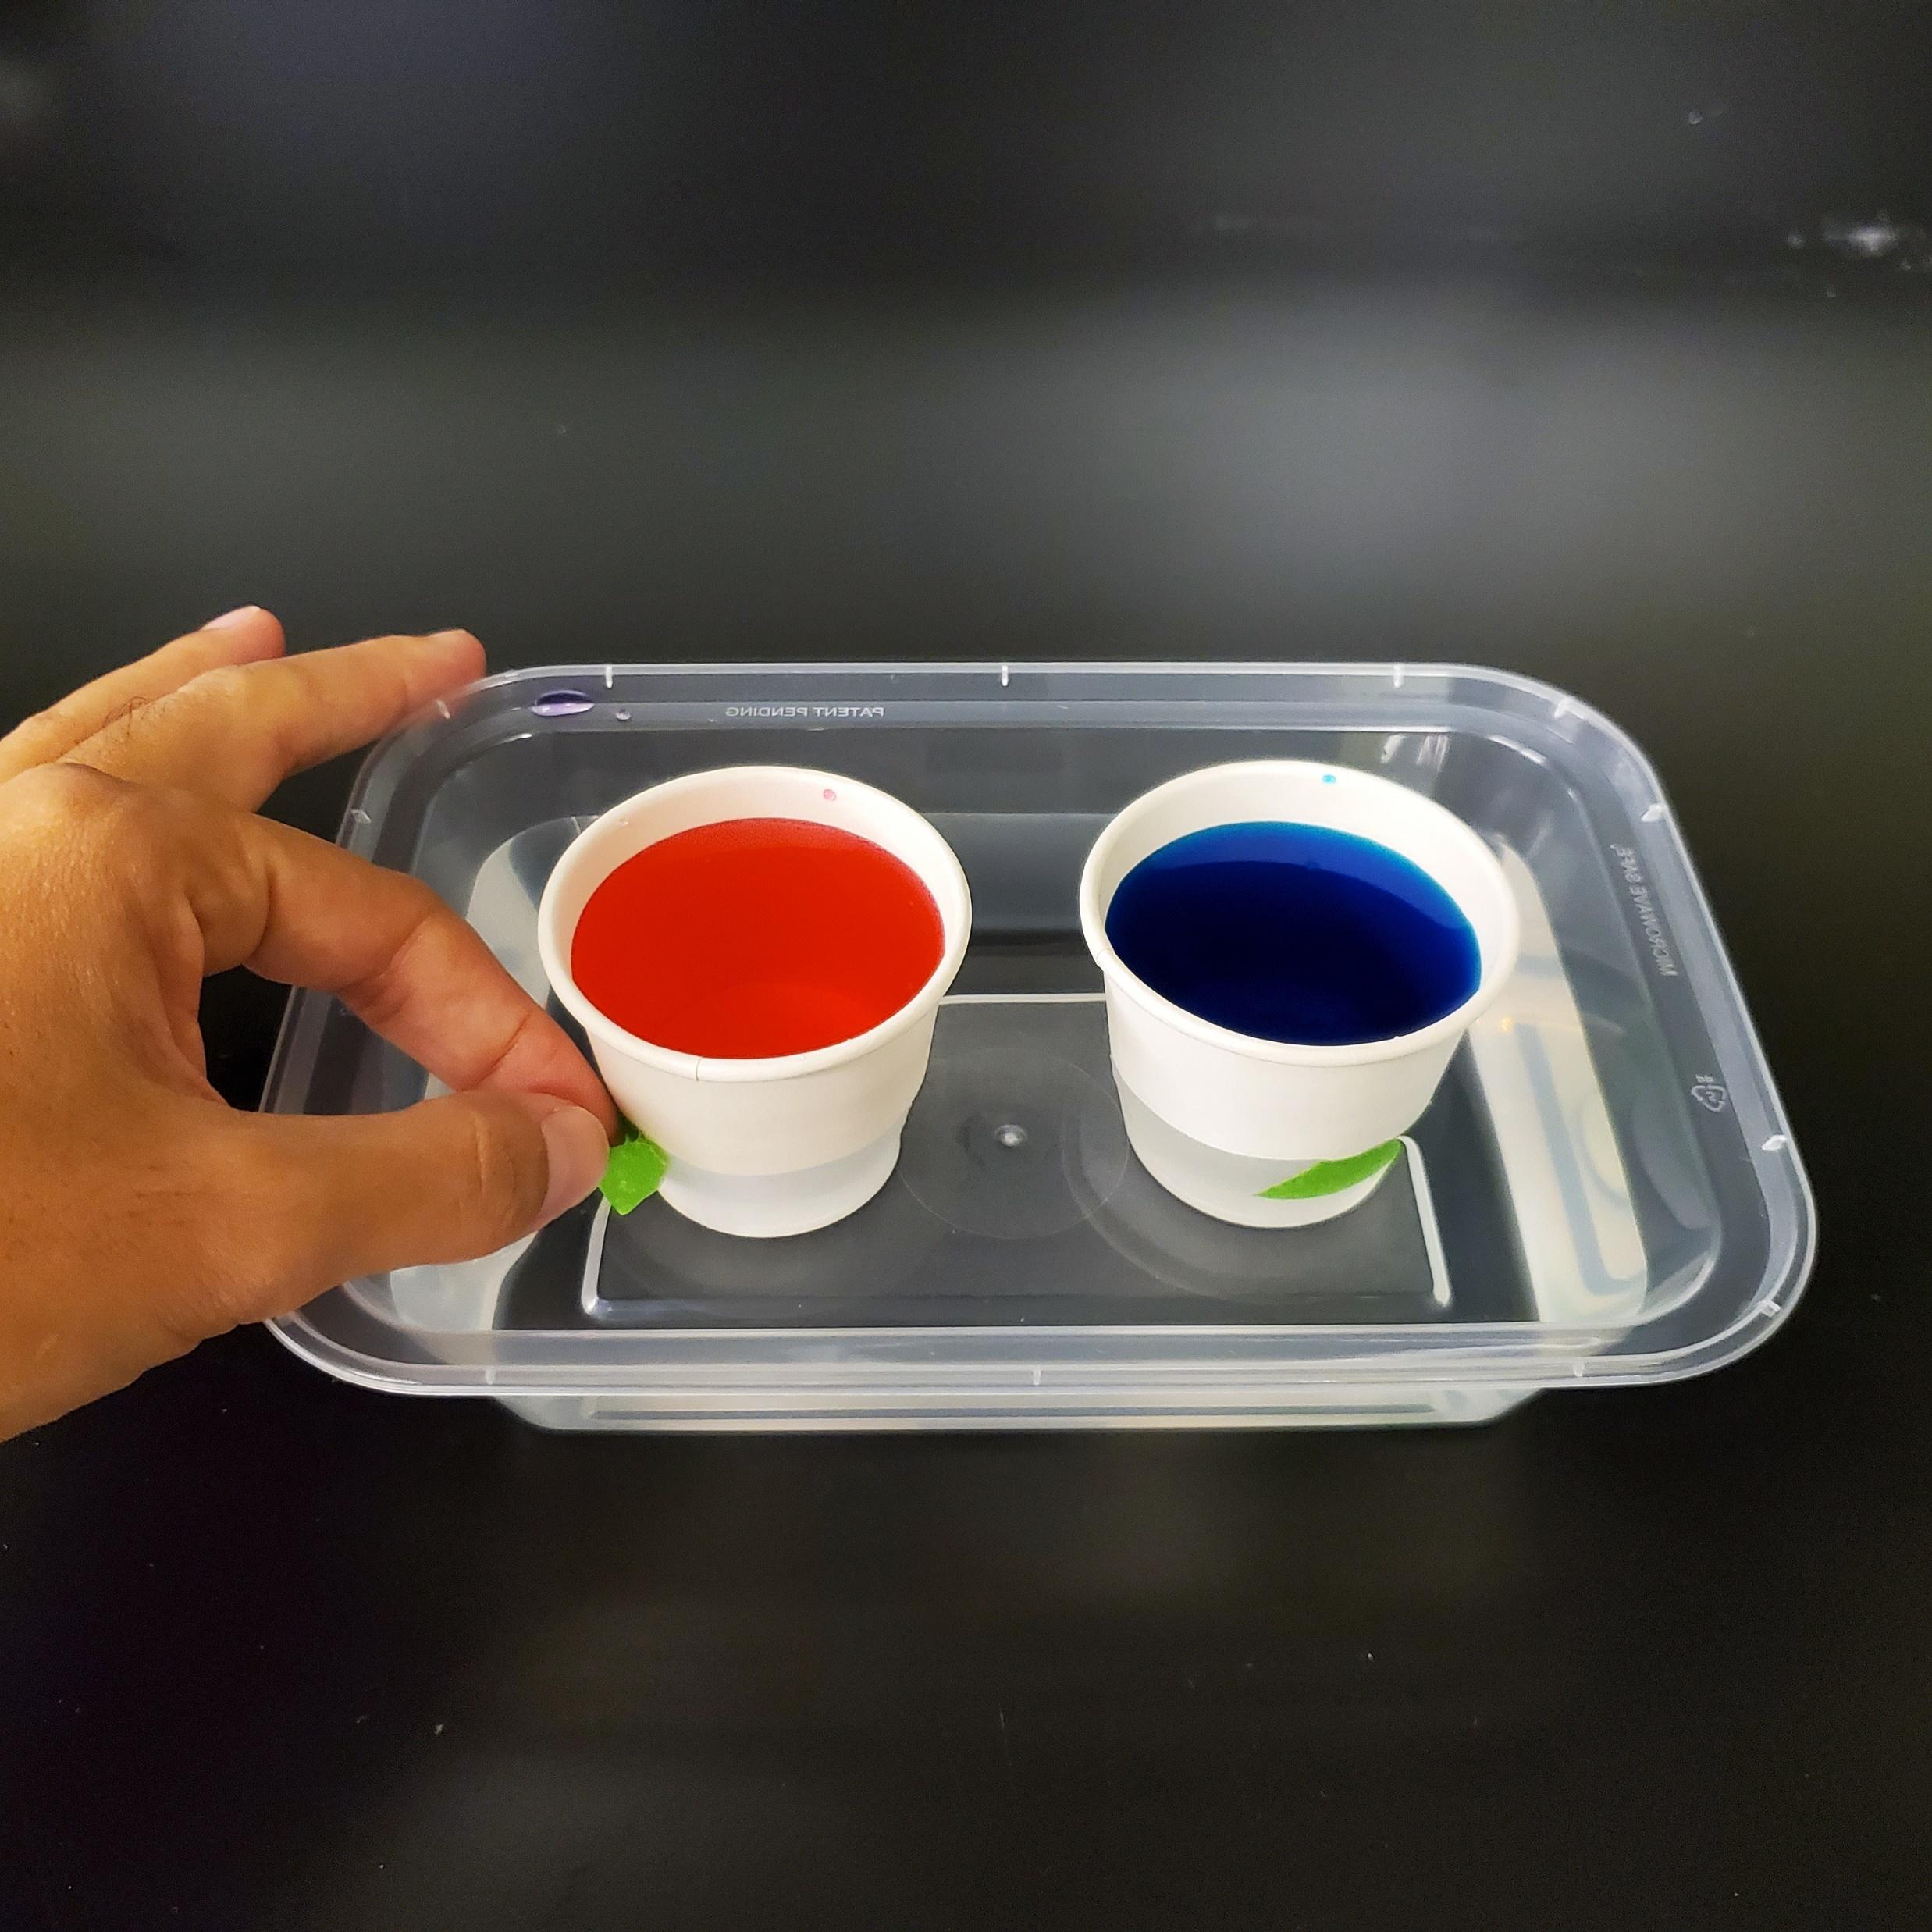
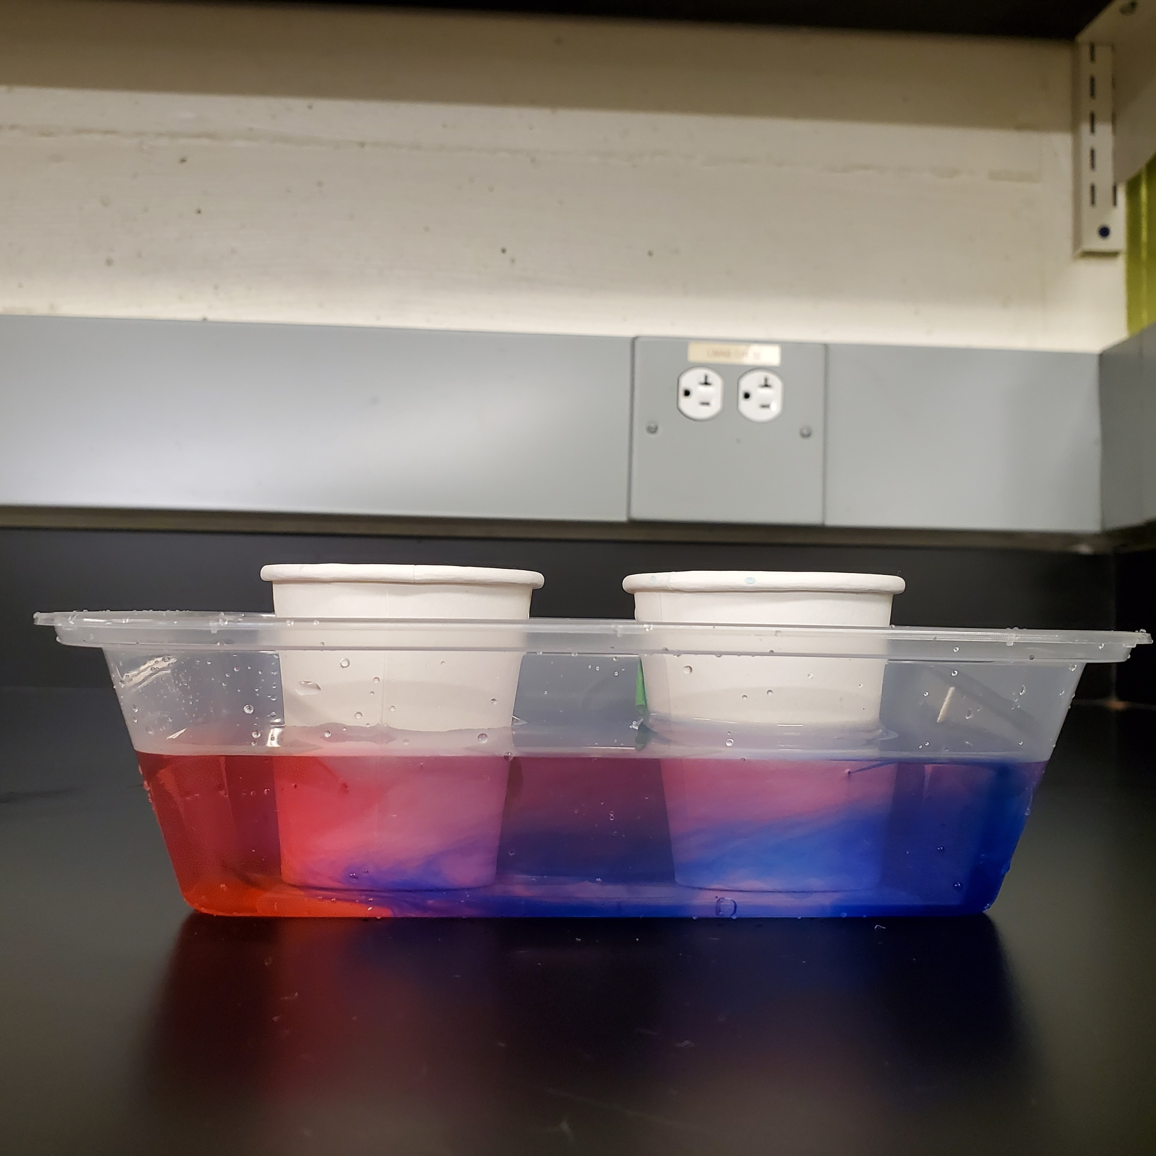
Experiment 2: cold water versus warm water
Step 5:
Gently remove the tapes off the warm cup and then off the cold cup.
Step 6:
Observe the colored flows you created for a few minutes. What happens?

Slide 17
Experiment 2: cold water versus warm water
What was our main finding?
We found that cold water is heavier than warm water!
Do you remember what we found in the previous experiment?
We found that saltwater is heavier than freshwater!
How can these findings help us to understand
ocean movement? Let’s check it out!
Notes:
How it works? As you place the ducks in cups with different waters (freshwater versus saltwater), you will learn that the saltwater is denser than the freshwater, since the ducks will float in one cup and sink in the other.
Gif: https://www.youtube.com/watch?v=p4pWafuvdrY

Slide 18
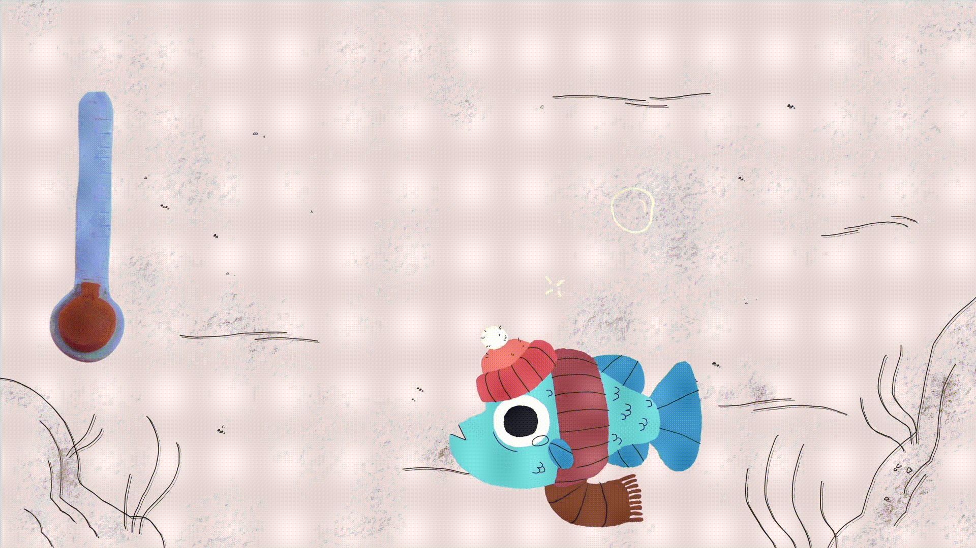
In the poles, waters are cold and salty: they are heavy!
How do ocean currents work? - Jennifer Verduin - YouTube
Notes:
How it works? As you place the ducks in cups with different waters (freshwater versus saltwater), you will learn that the saltwater is denser than the freshwater, since the ducks will float in one cup and sink in the other.
Gif: https://www.youtube.com/watch?v=p4pWafuvdrY

Slide 19
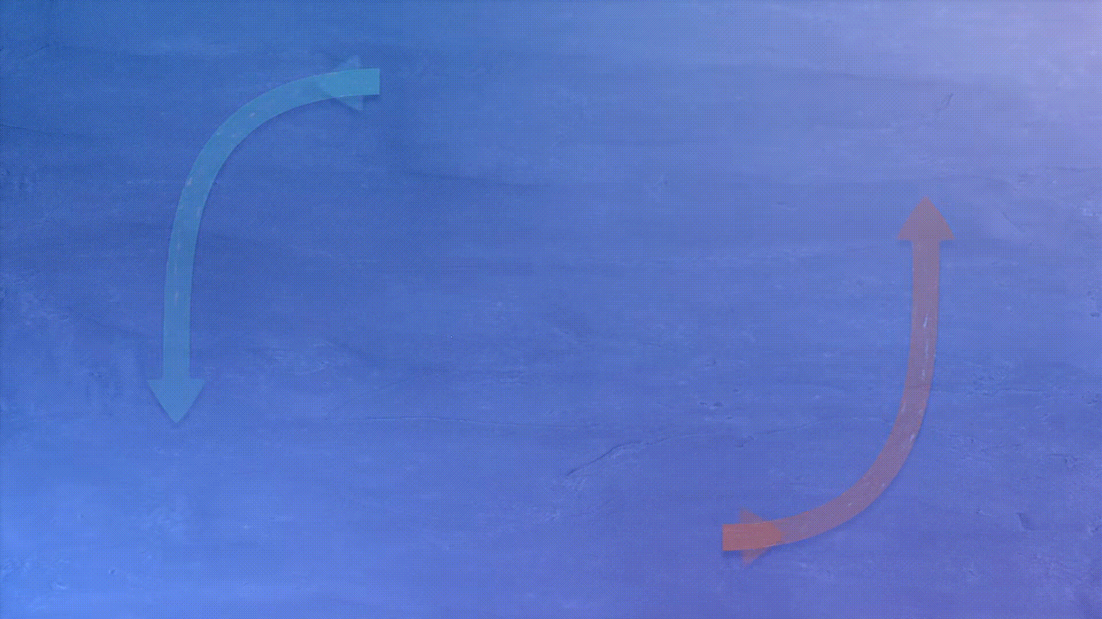
Heavier waters will sink to the deep ocean
How do ocean currents work? - Jennifer Verduin - YouTube
Notes:
How it works? As you release the water from the paper cups into the plastic tray, you will learn that cold waters are denser than warm waters, because once the colored flows meet, the cold water will flow downwards and the warm water will flow upwards.
Gif: https://www.youtube.com/watch?v=p4pWafuvdrY

Slide 20
And warm waters will replace heavier waters in the surface
How do ocean currents work? - Jennifer Verduin - YouTube
Notes:
How it works? As you release the water from the paper cups into the plastic tray, you will learn that cold waters are denser than warm waters, because once the colored flows meet, the cold water will flow downwards and the warm water will flow upwards.
Gif: https://www.youtube.com/watch?v=p4pWafuvdrY

Slide 21
That’s how the ocean transports heat to different regions!
How do ocean currents work? - Jennifer Verduin - YouTube
Notes:
How it works? As you release the water from the paper cups into the plastic tray, you will learn that cold waters are denser than warm waters, because once the colored flows meet, the cold water will flow downwards and the warm water will flow upwards.
Gif: https://www.youtube.com/watch?v=p4pWafuvdrY

Slide 22
We just learned how the global powerful circulation works!
Temperature and salt drive the deep
global ocean movement.
But other things can affect ocean movement
more locally…
We can think about how water can move along our coasts with Experiment 3!
Notes:
How it works? As you place the ducks in cups with different waters (freshwater versus saltwater), you will learn that the saltwater is denser than the freshwater, since the ducks will float in one cup and sink in the other.
Gif: https://www.youtube.com/watch?v=p4pWafuvdrY

Slide 23
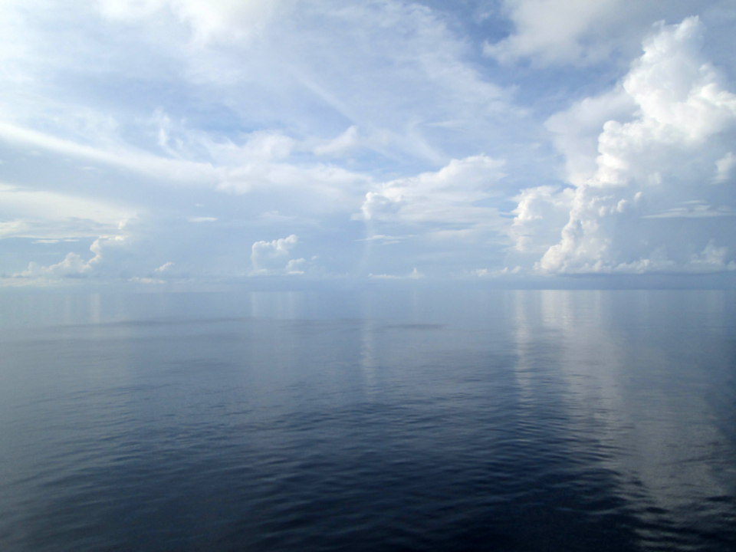
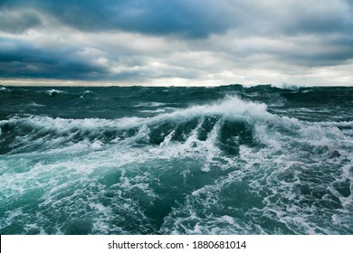
Experiment 3: turbulence in the water
Food for thought:
The ocean can be flat or very turbulent.
What do you think is the major force that causes that?

Slide 24
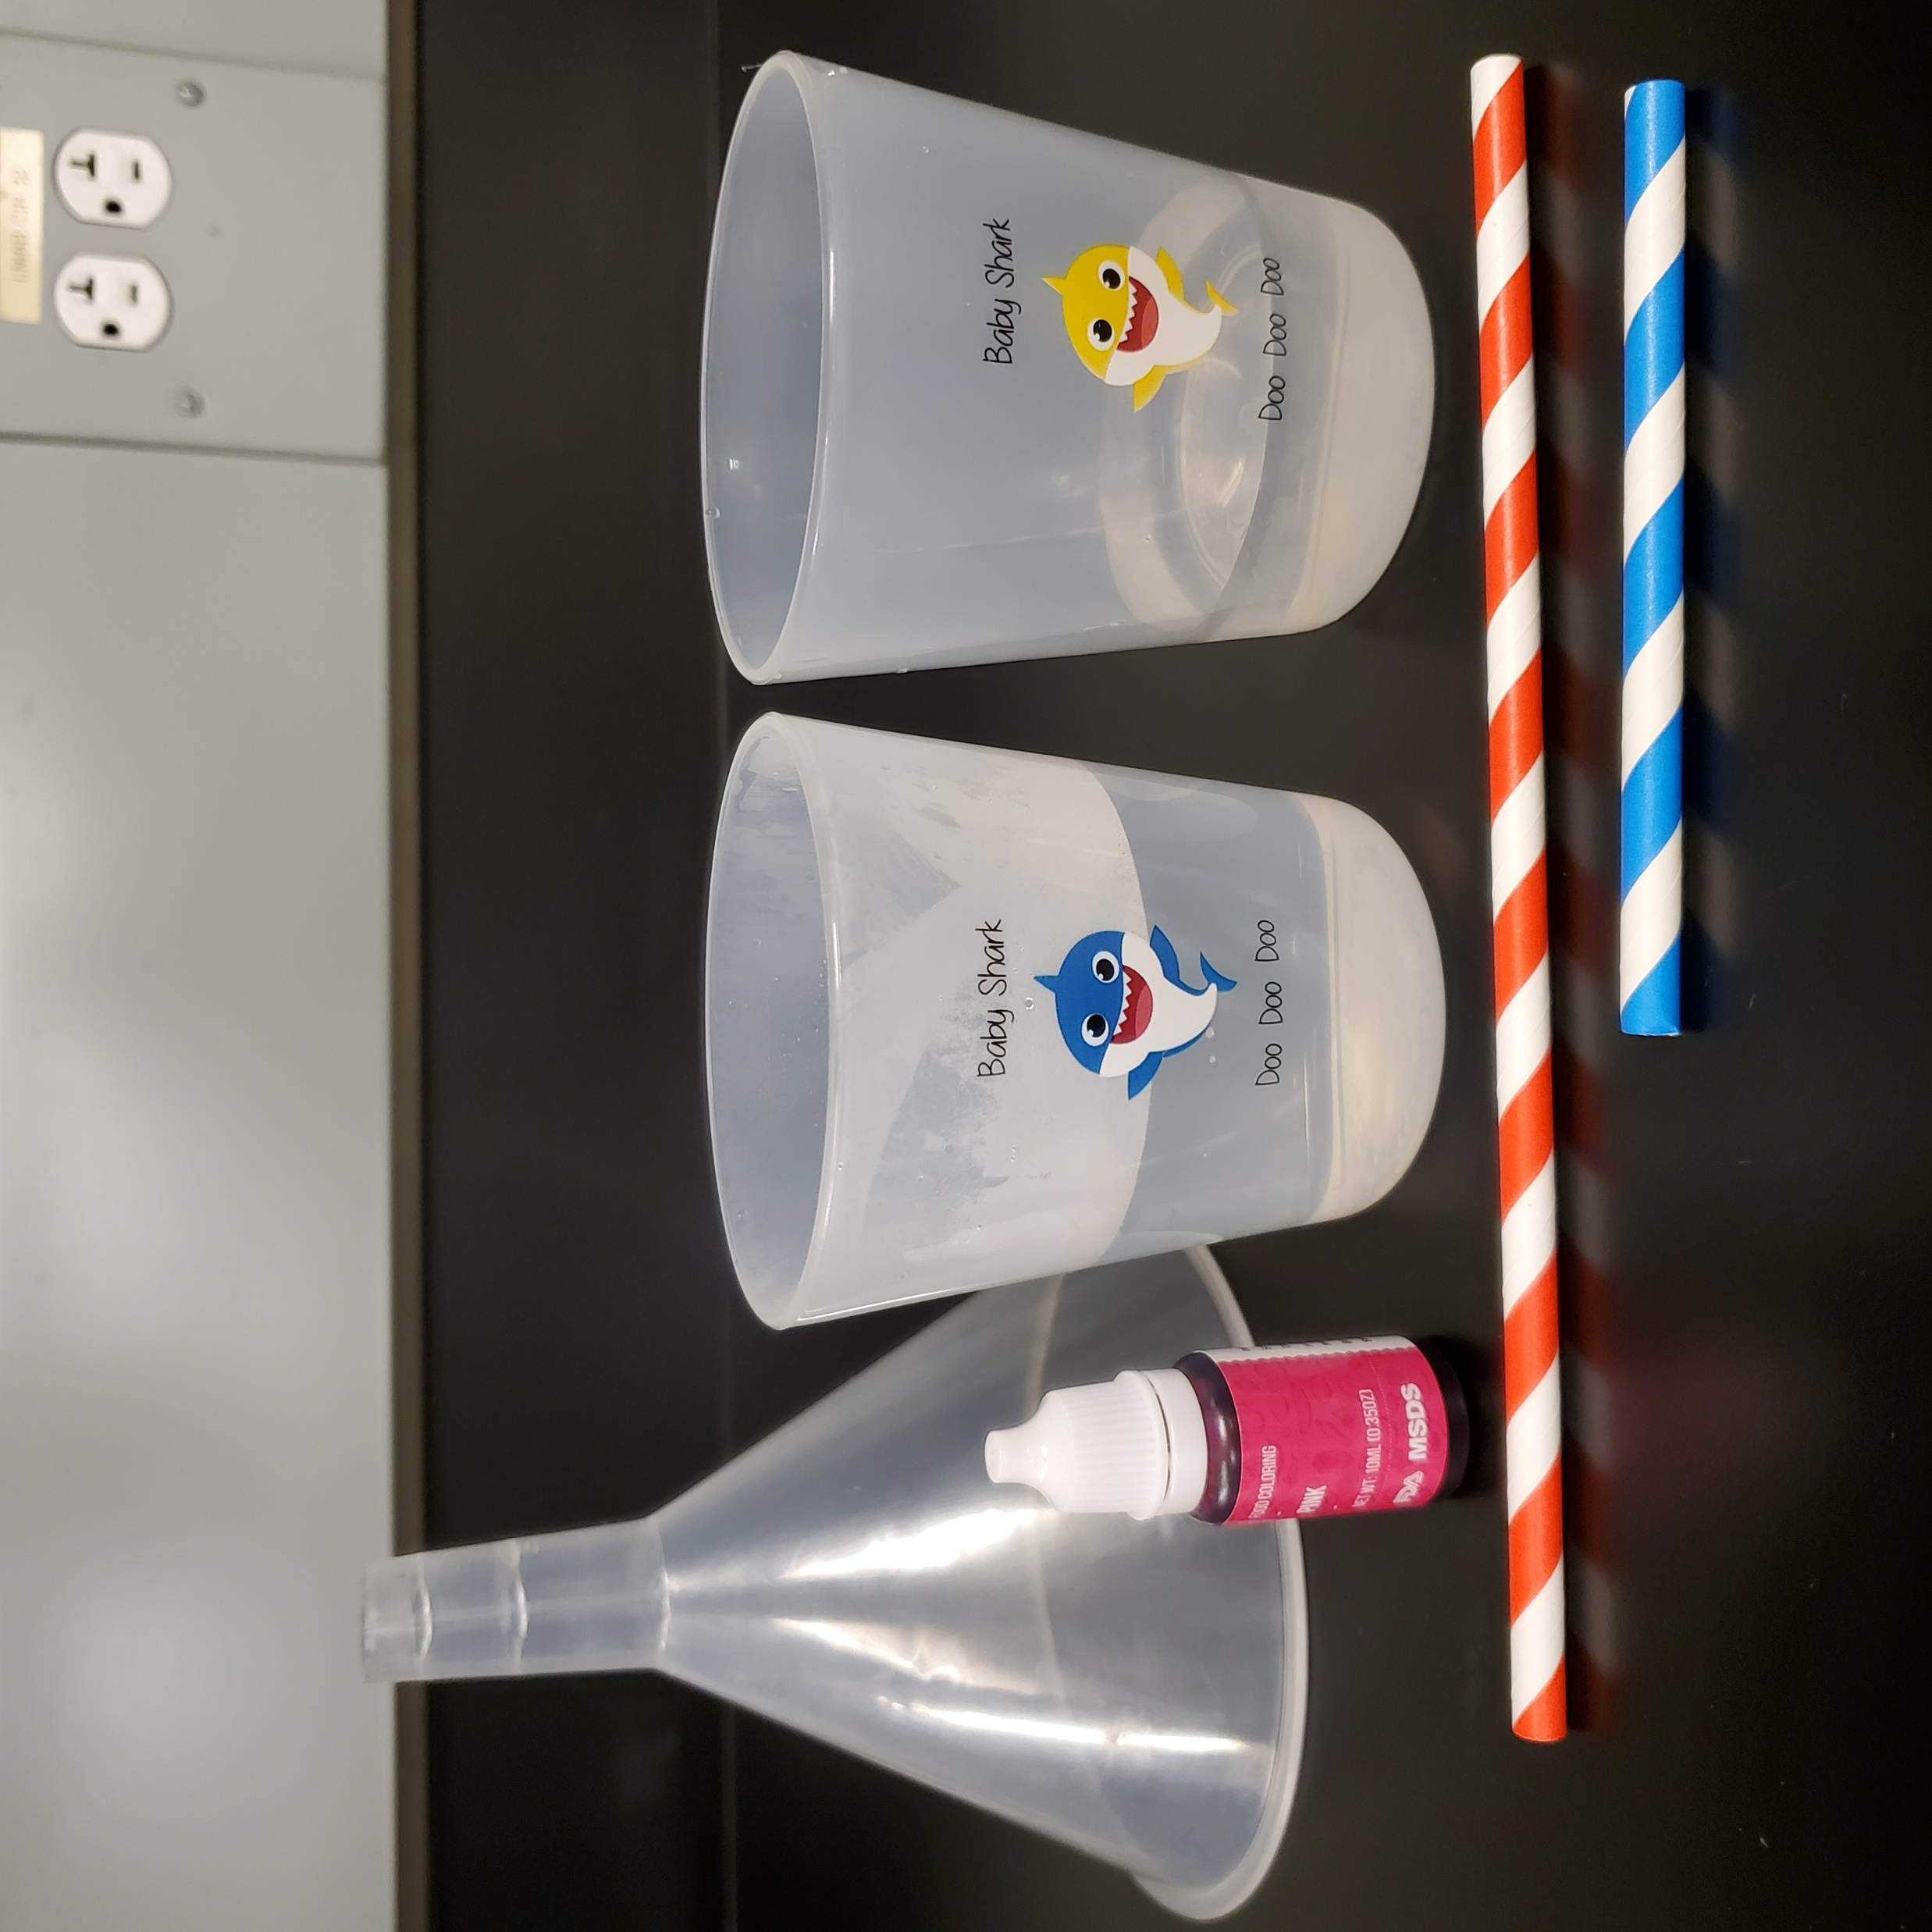
Experiment 3: turbulence in the water
What you will need:
2 plastic cups
1 plastic funnel
1 food coloring
1 paper straw
1 short paper straw
Cold & warm water

Slide 25
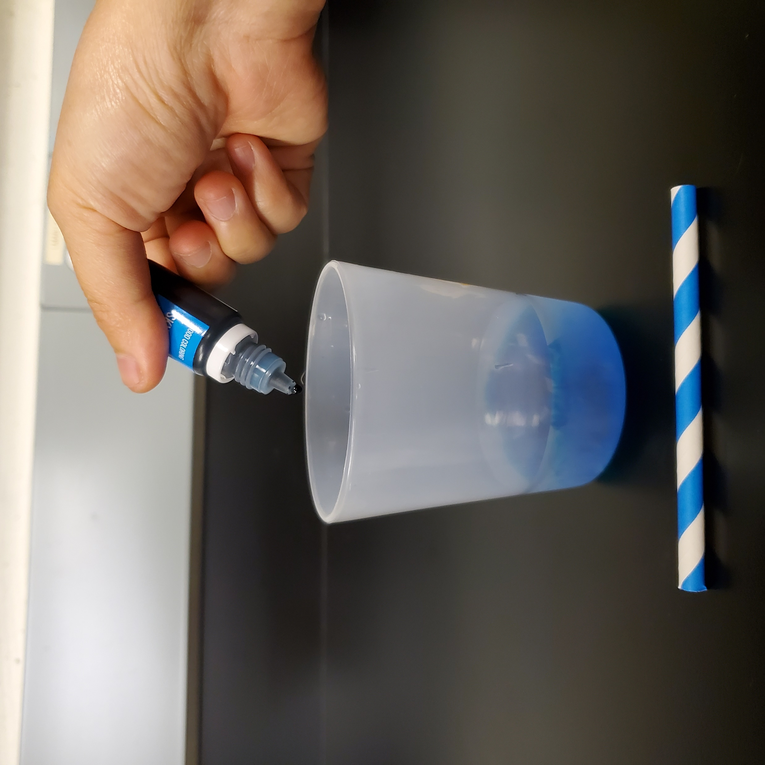
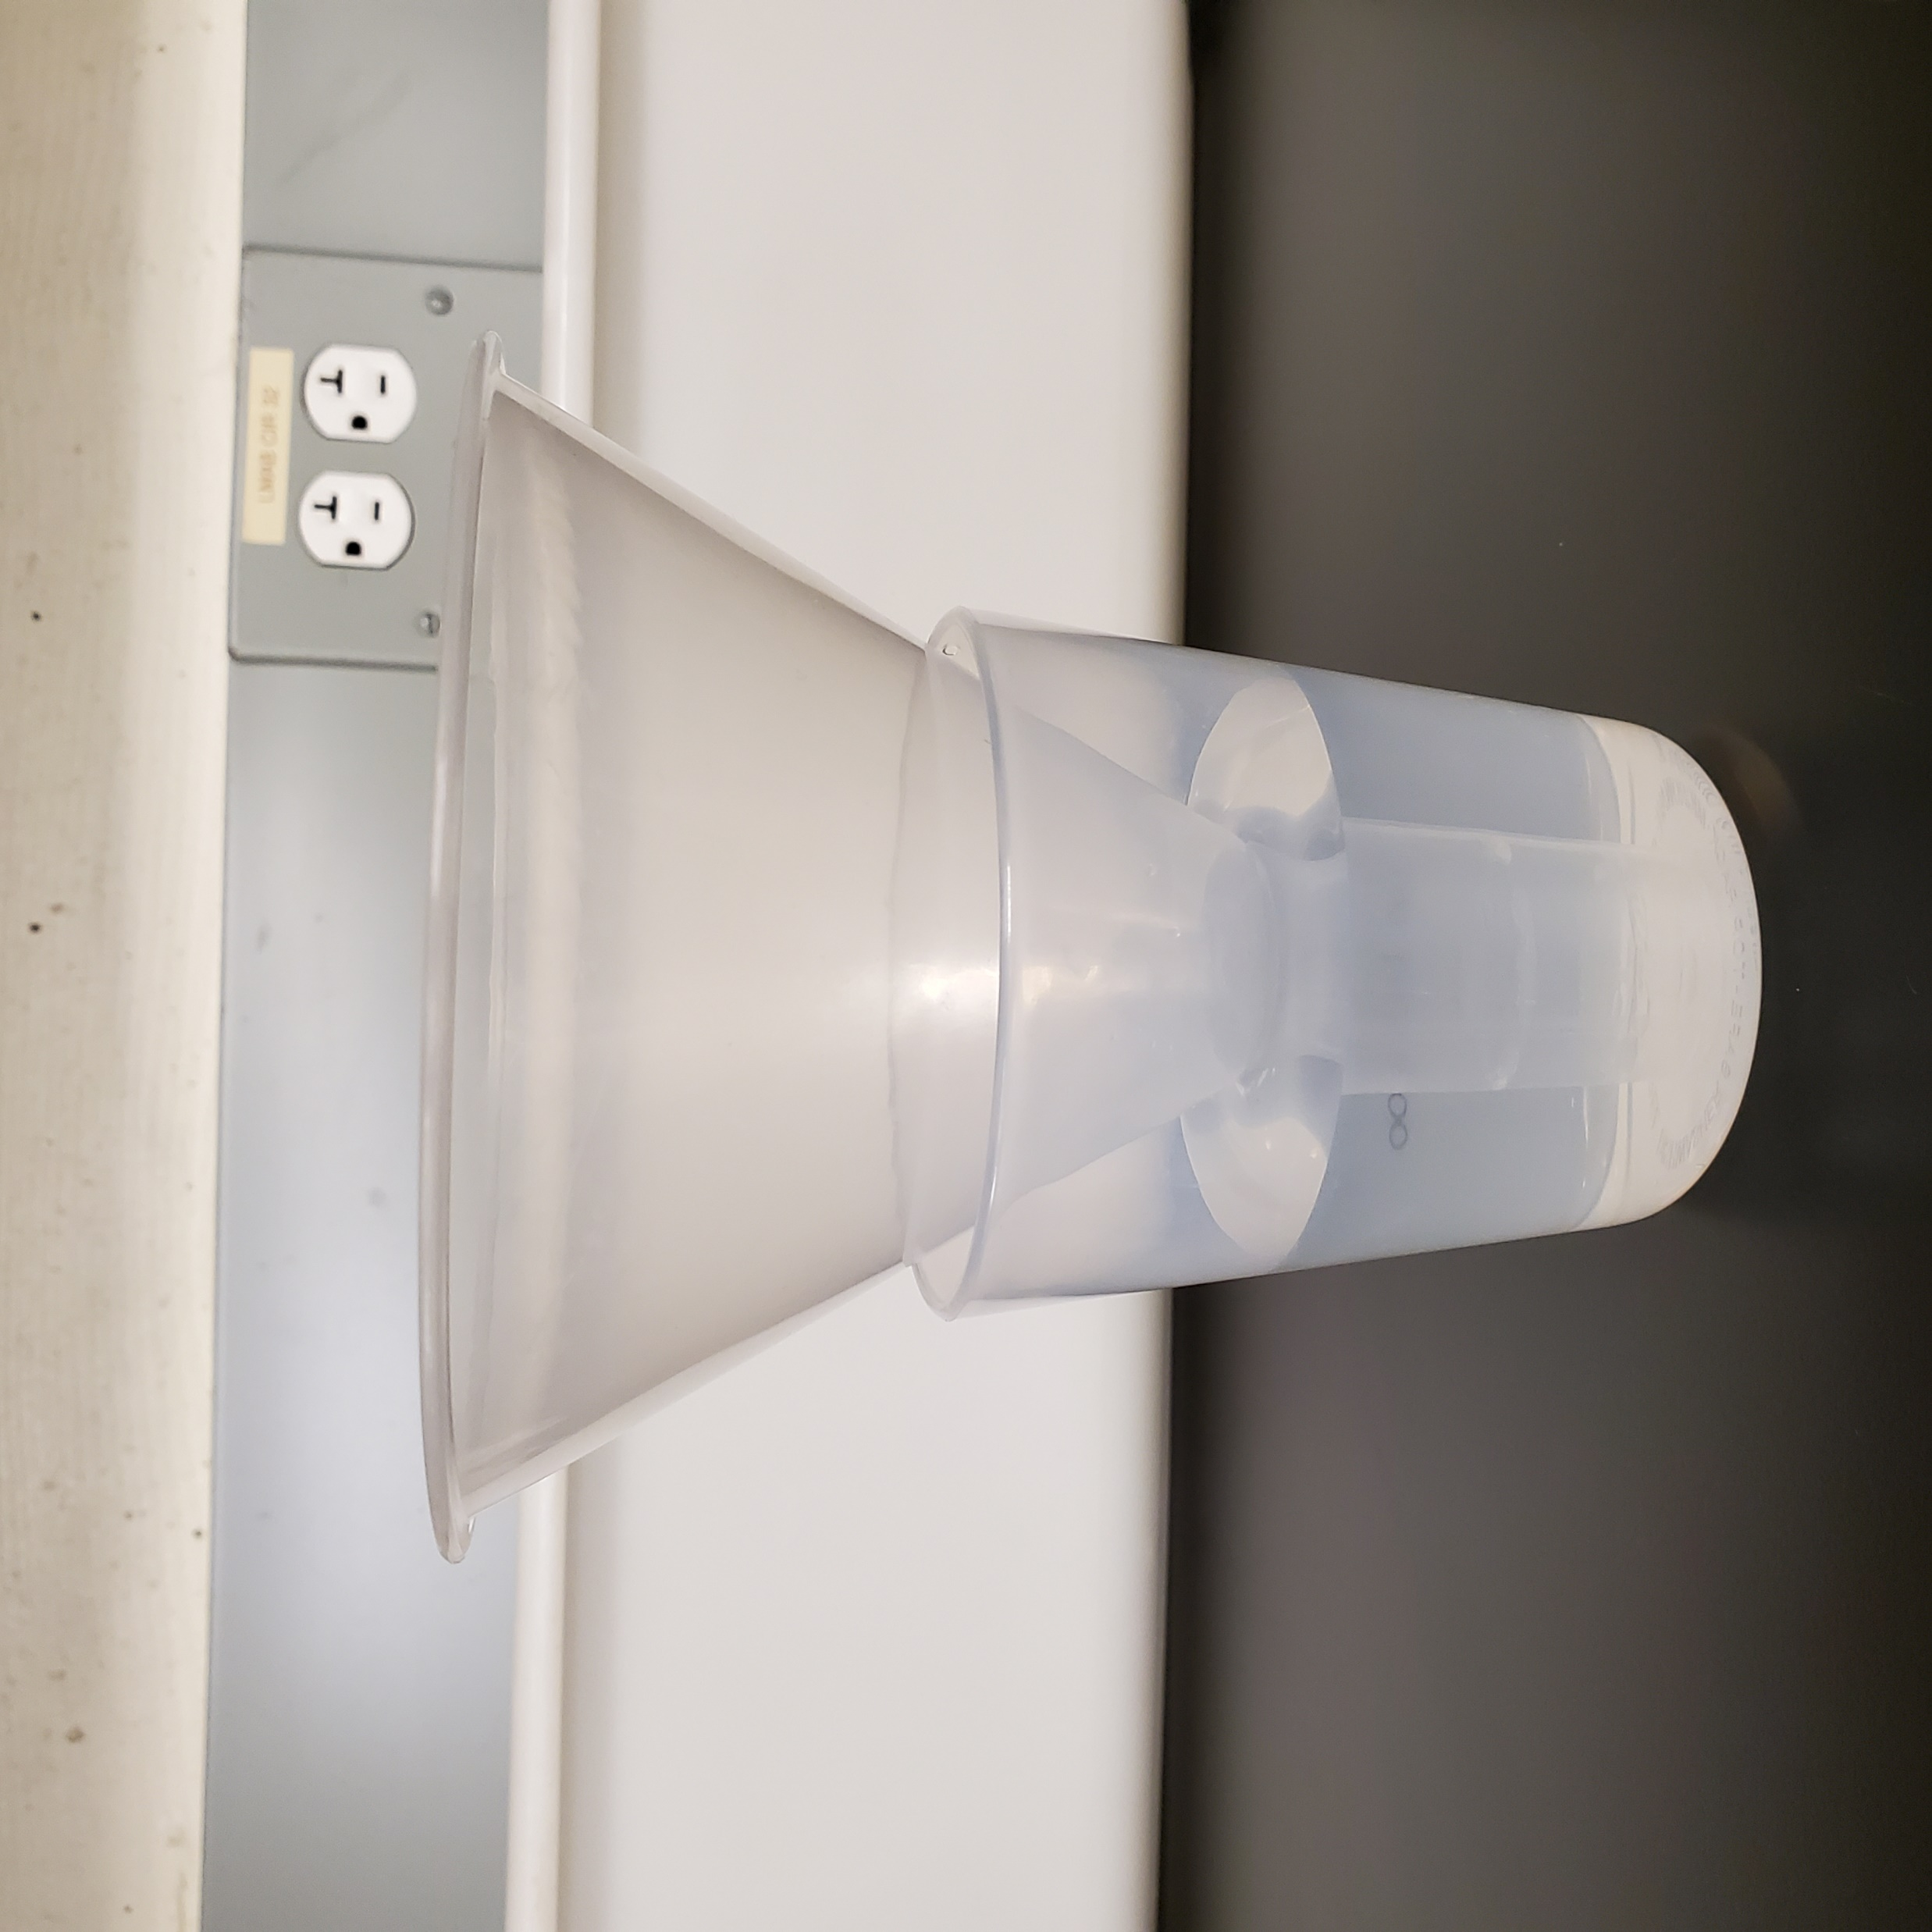
Experiment 3: turbulence in the water
Step 1:
Fill ¼ of the plastic cup with cold water, add 6 drops of food coloring and stir it well.
Step 2:
Fill 2/3 of the other cup with warm water and gently position the plastic funnel in it.

Slide 26
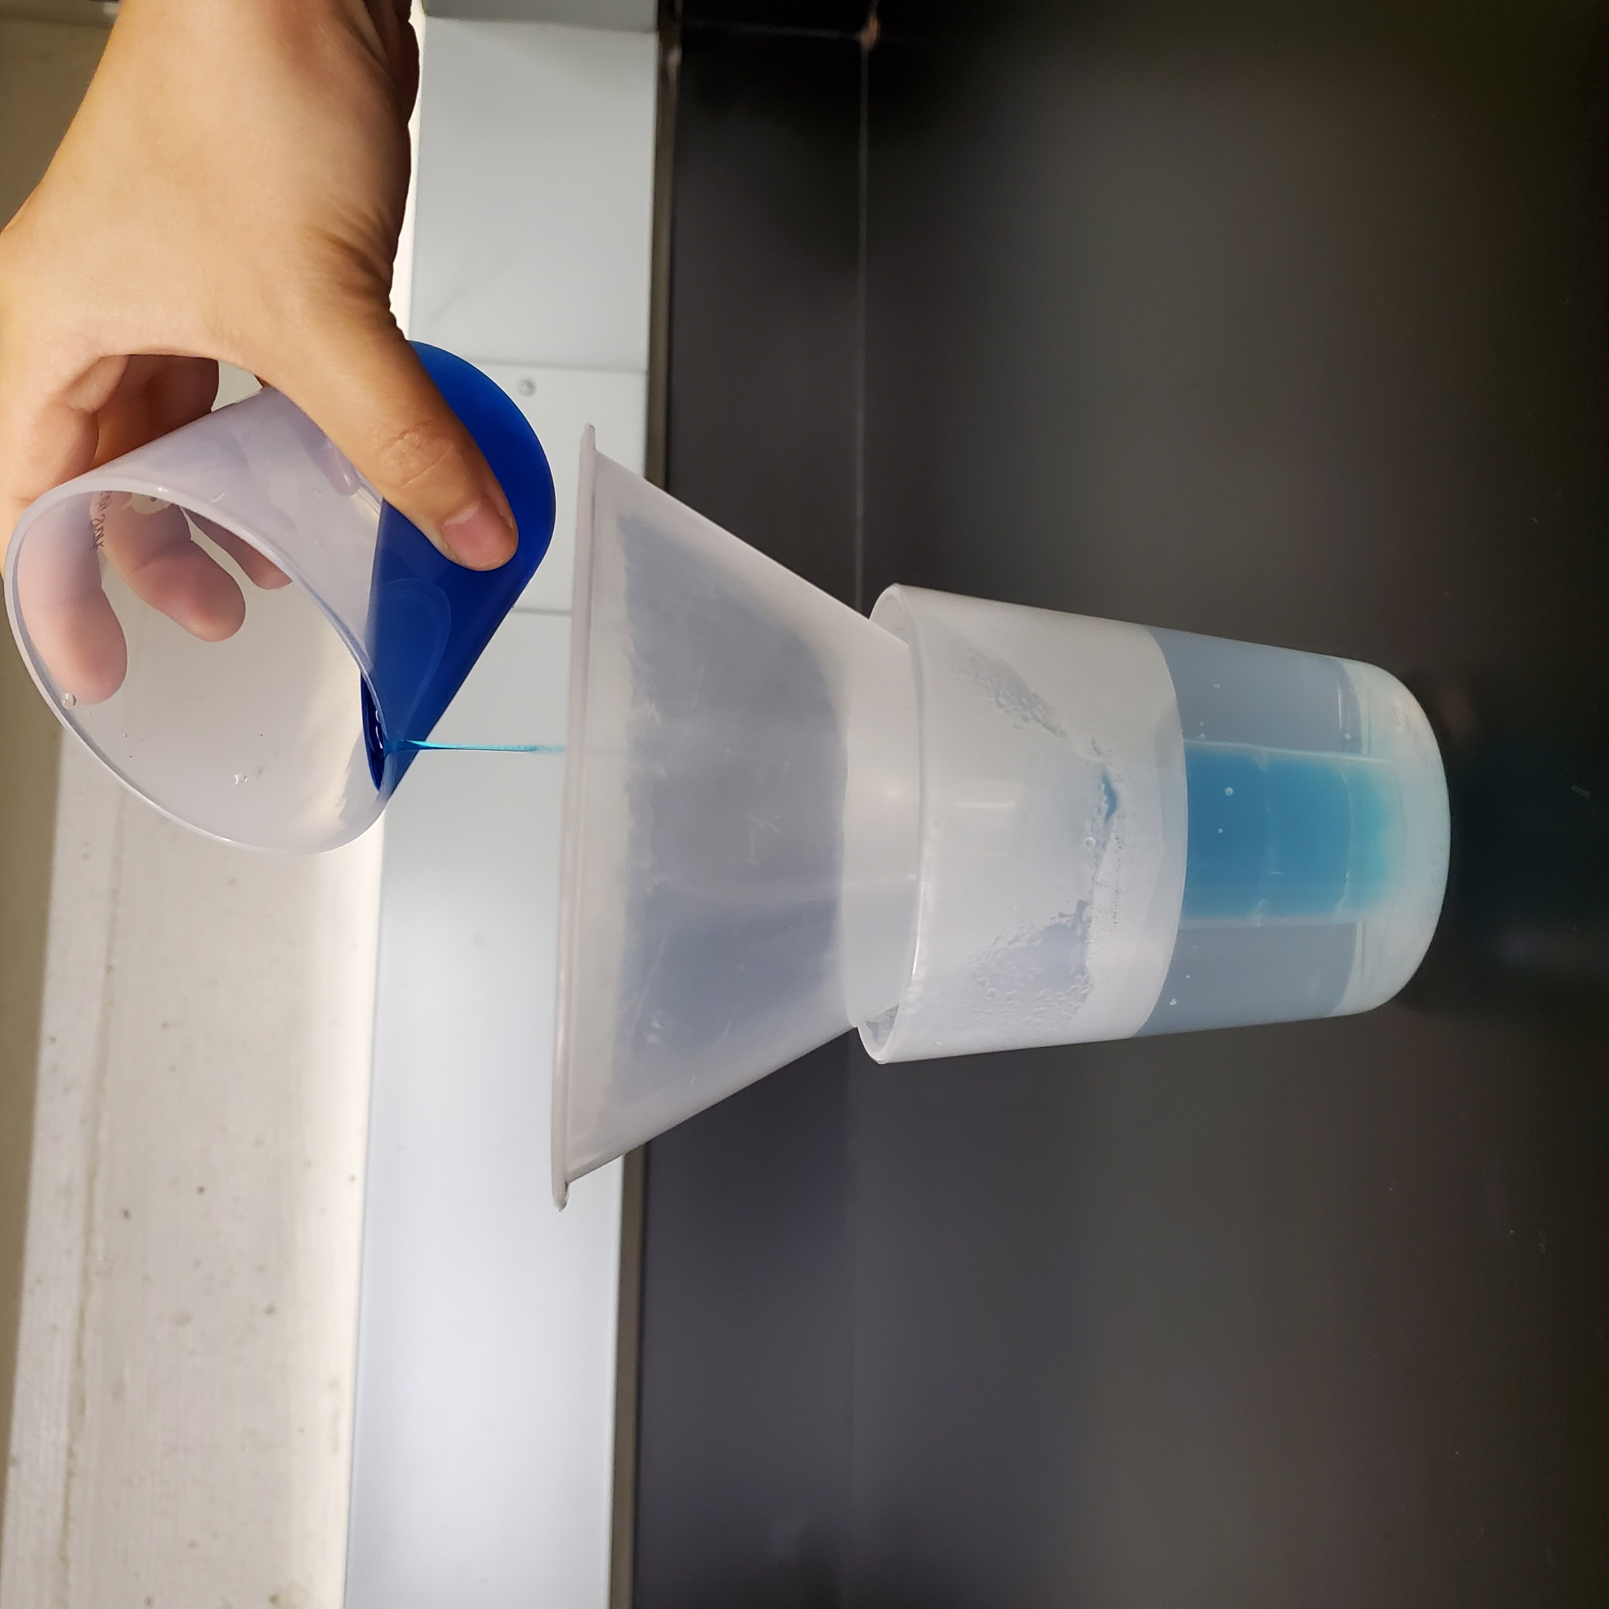
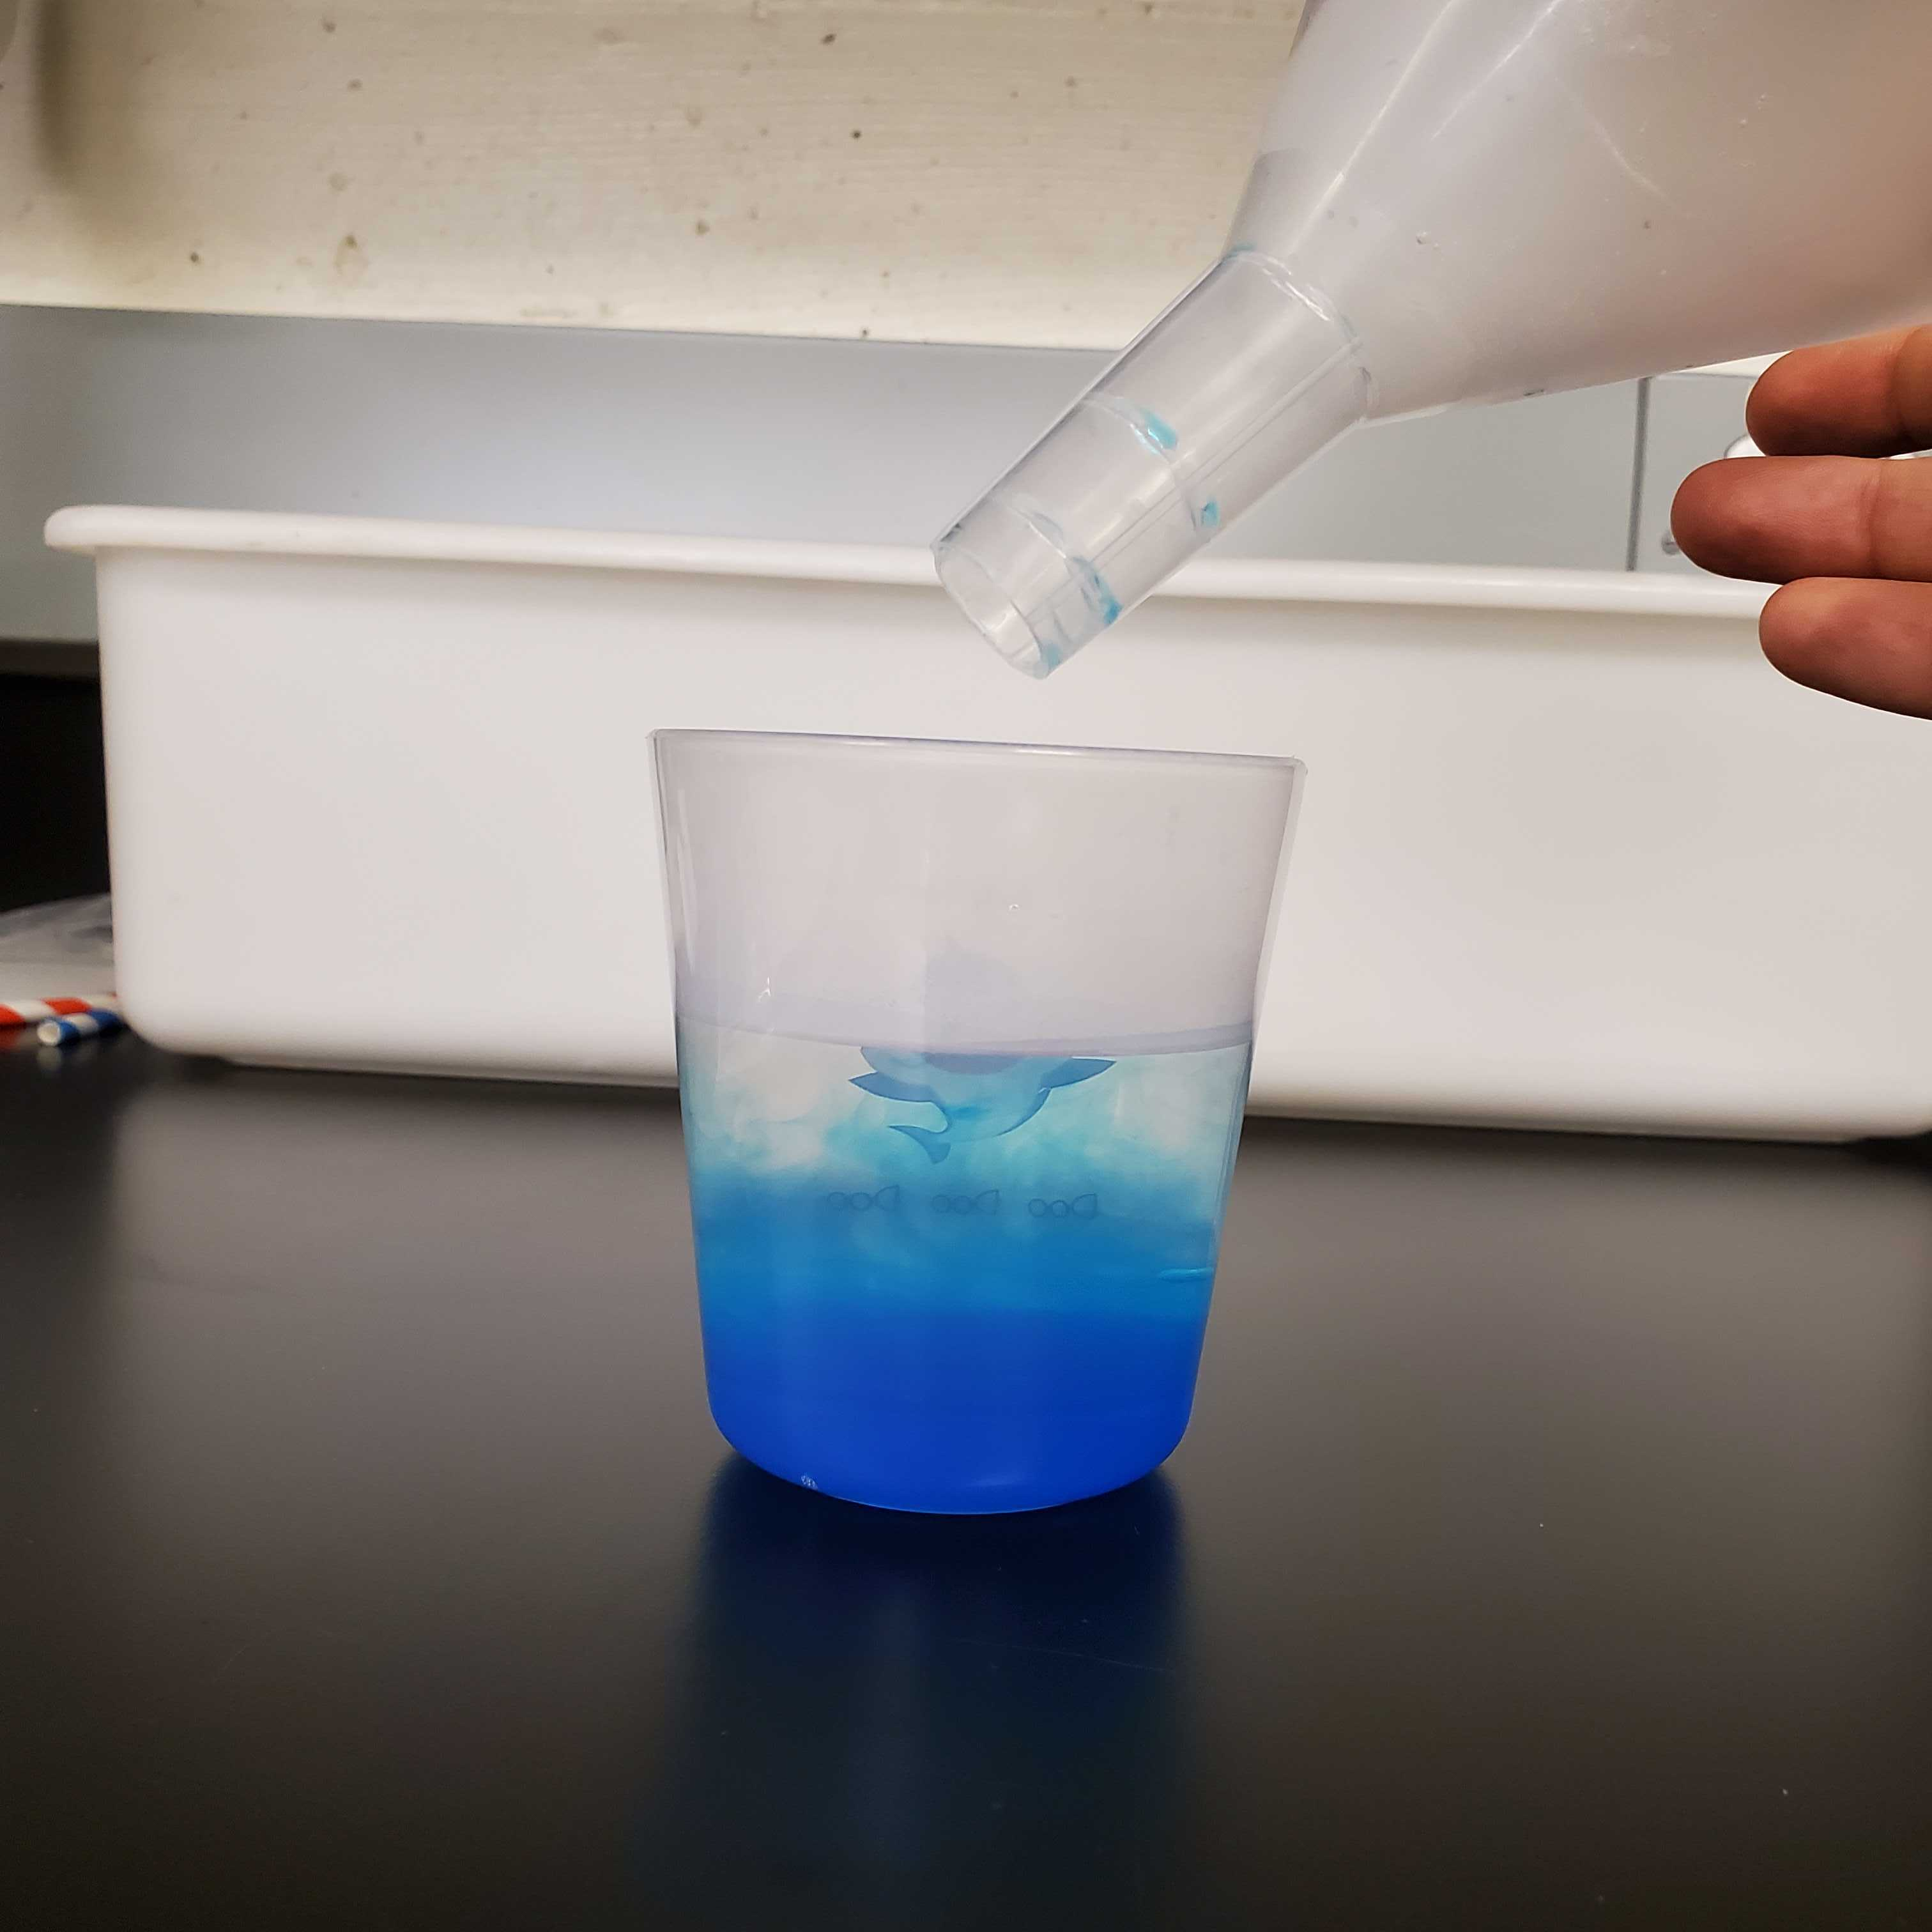
Experiment 3: turbulence in the water
Step 3:
Gently add a little bit of the cold colored water through the funnel.
Step 4:
Gently remove the funnel and check what happens at the bottom of the cup.

Slide 27
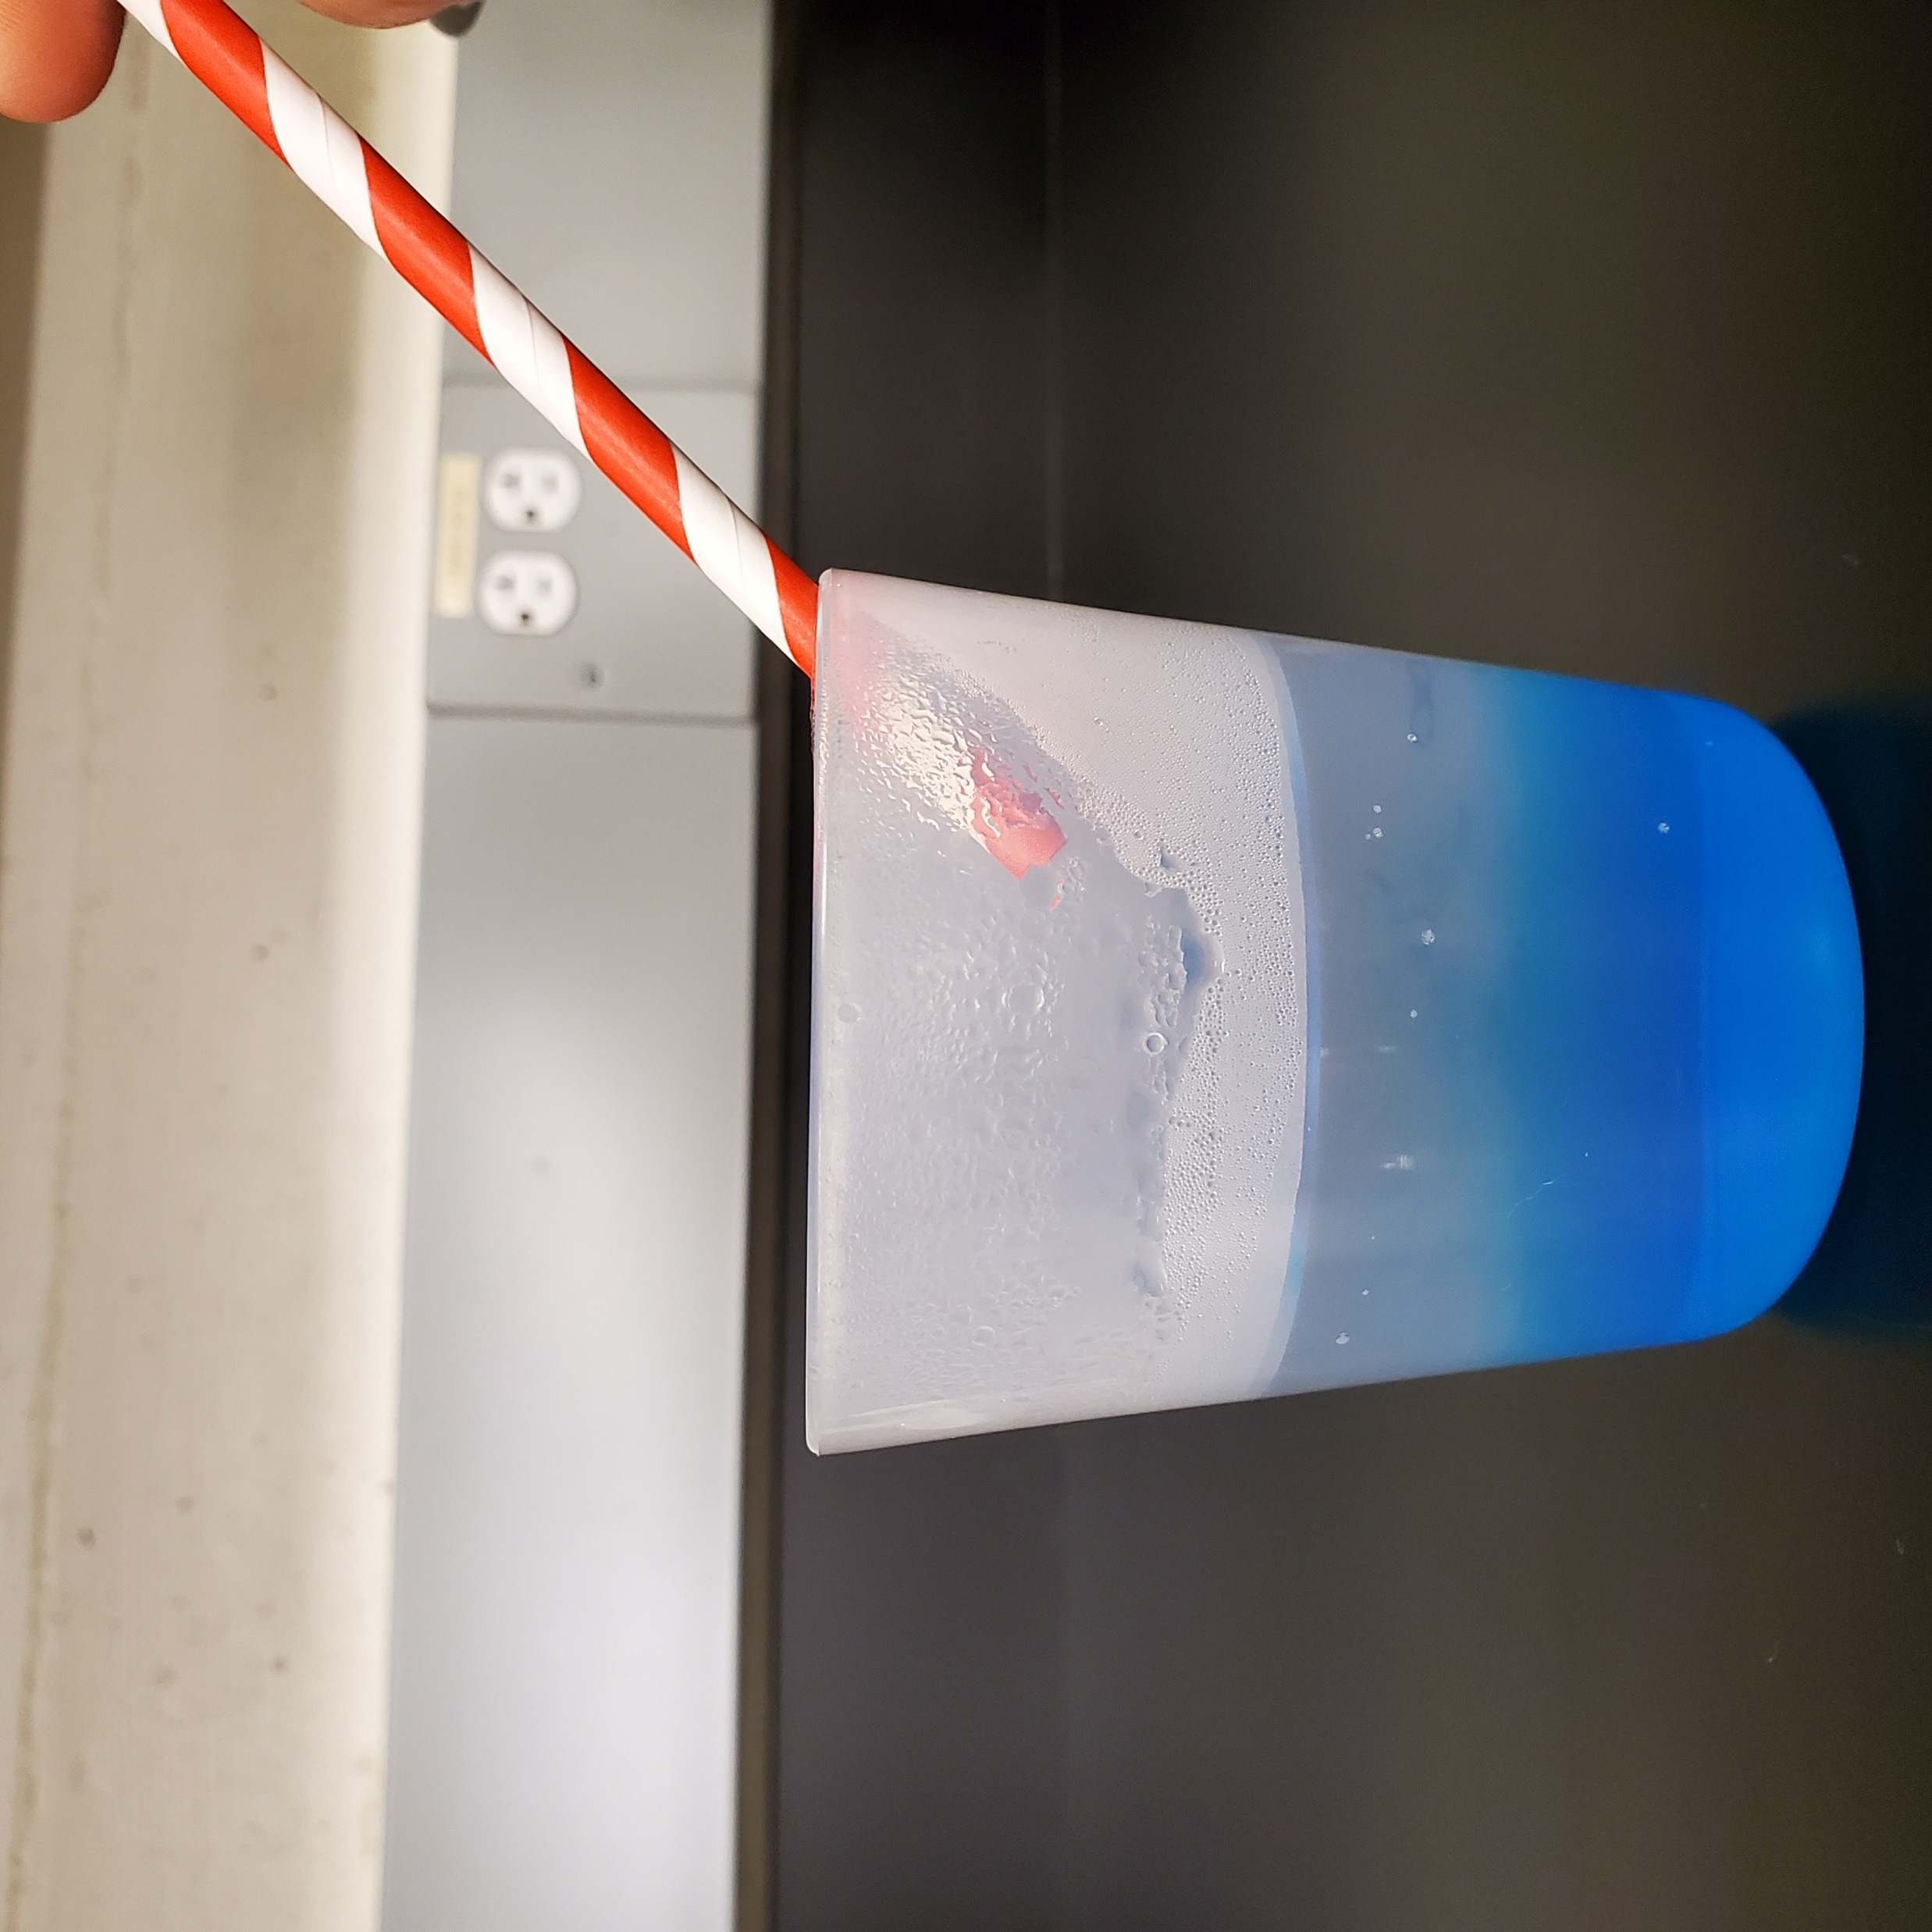
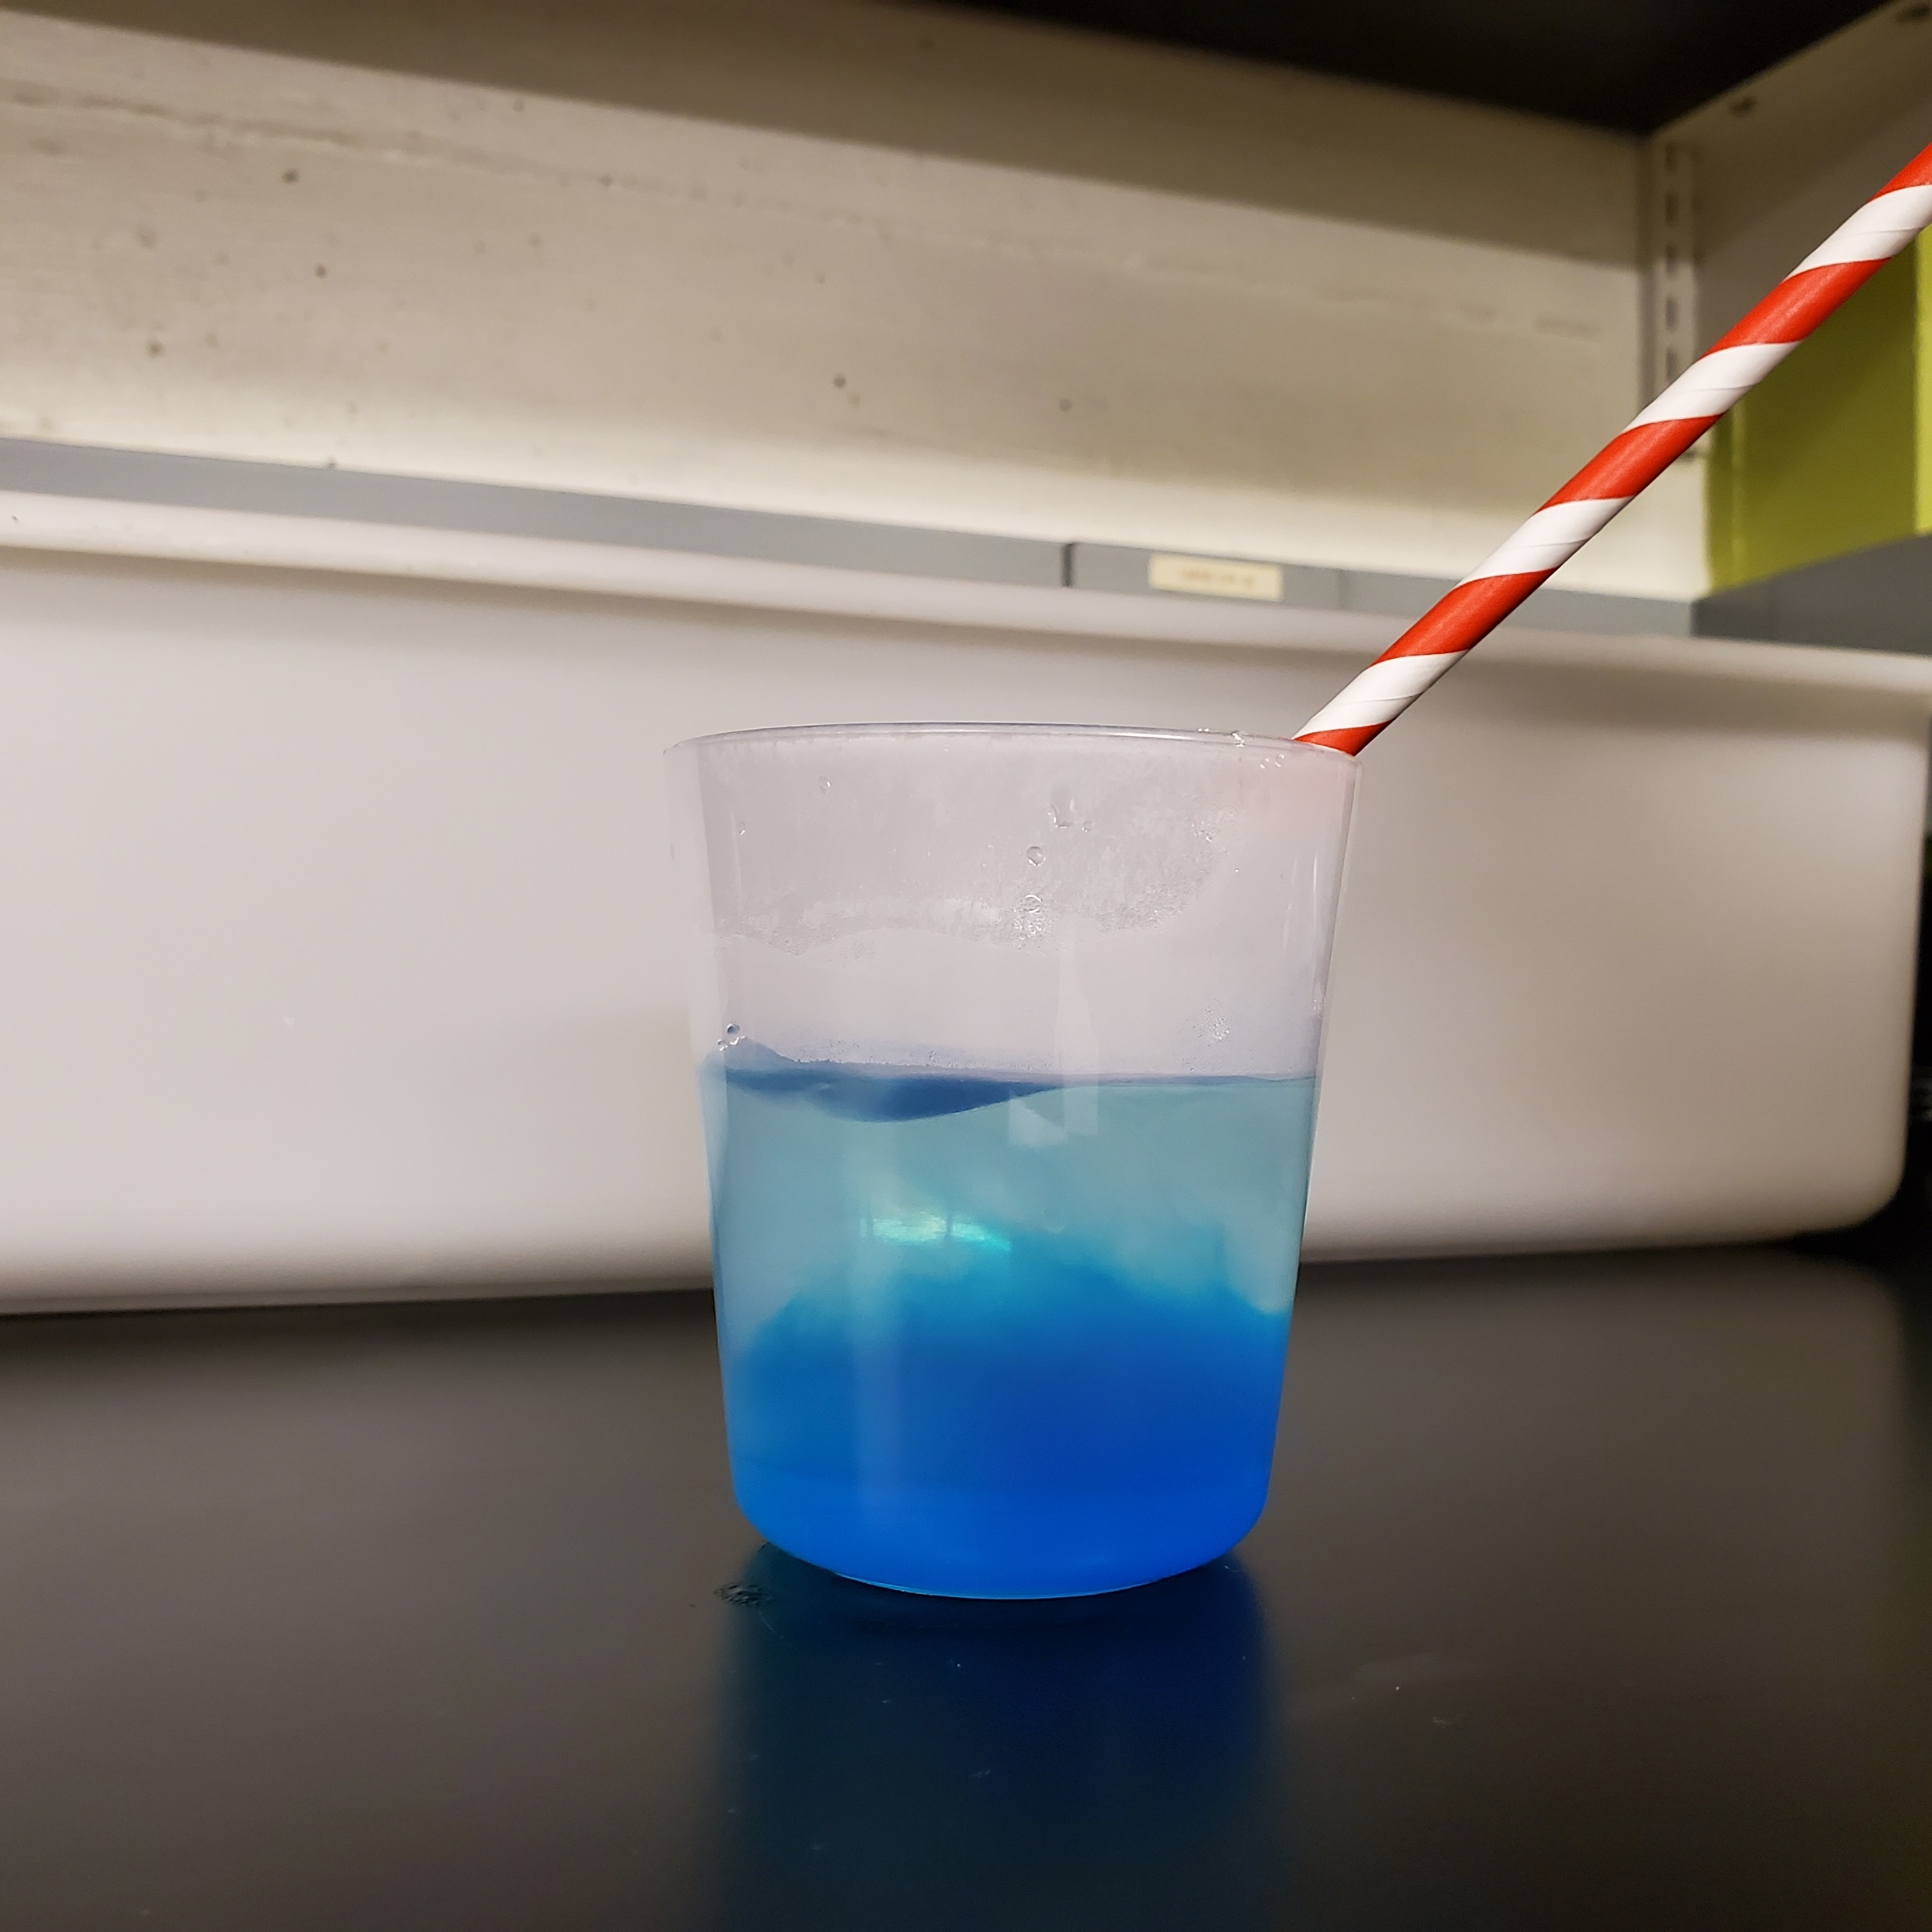
Experiment 3: turbulence in the water
Step 5:
Position the straw in a diagonal angle (but do not touch the water surface).
Step 6:
Now blow through the straw and look to the side of the cup! What happens?

Slide 28
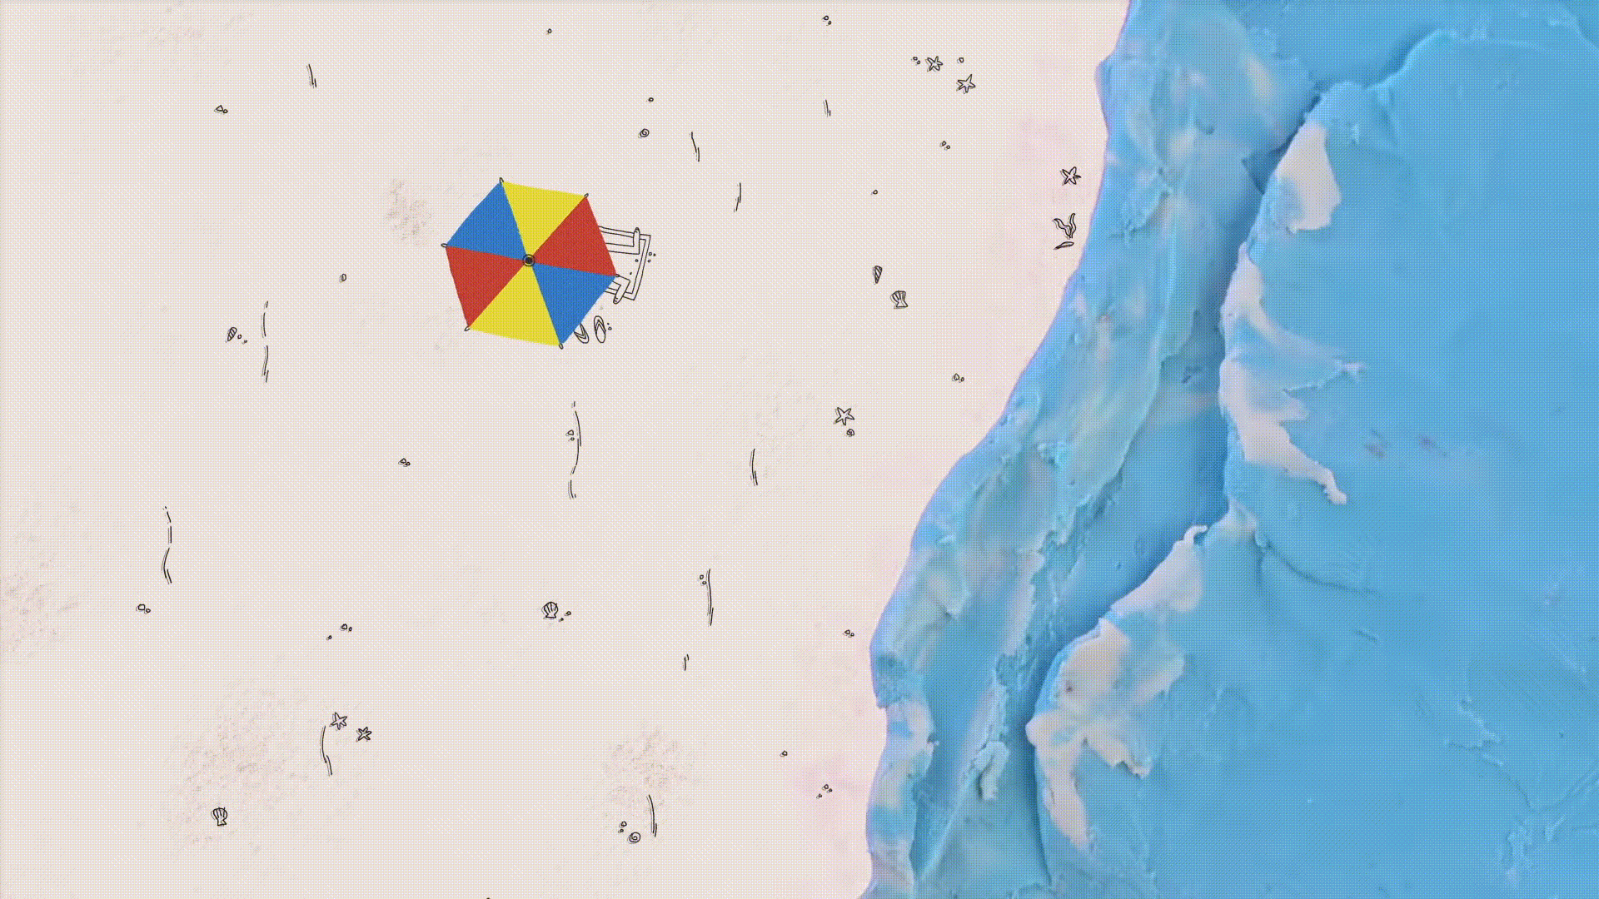
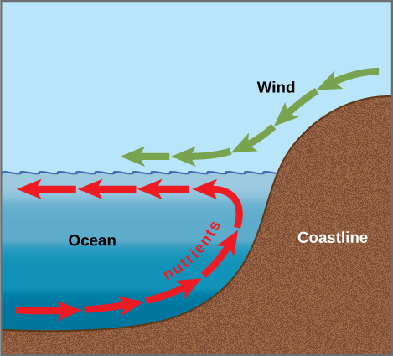
Experiment 3: turbulence in the water
How do ocean currents work? - Jennifer Verduin - YouTube
Notes:
As you know, cold water is heavier than warm water. For this reason, the cold water stays at the bottom of the cup. Blowing through the straw creates whirl, bringing the cold water near the surface.
Gif: https://www.youtube.com/watch?v=p4pWafuvdrY

Slide 29
Experiment 3: turbulence in the water
What was our main finding?
We found that strong winds along the coasts can help to bring deeper and heavier waters to the surface.
This can cause “upwelling” and it is great to promote a vibrant marine life!
Notes:
As you know, cold water is heavier than warm water. For this reason, the cold water stays at the bottom of the cup. Blowing through the straw creates whirl, bringing the cold water near the surface.
Gif: https://www.youtube.com/watch?v=p4pWafuvdrY

Slide 30
You can now say that you are a junior ocean scientist!
Salt!
Temperature!
Wind!
How do ocean currents work? - Jennifer Verduin - YouTube
Notes:
Gif: https://www.youtube.com/watch?v=p4pWafuvdrY

Slide 31
Session 1:
How do oceans move?
Created by:
*Ocean scientists*
USC postdocs
Brittany Bennett
Holland Elder
Jake Weissman
Jesse McNichol
Nicole Ratib
Suzana Leles
Trang Nguyen
In collaboration with:
LA public libraries & NeiSci
Art: Claudia Traboni
@ocean_sci_art
Notes:
Today we will explore how oceans move! We prepared three fun experiments to investigate this question. You will need your hands-out for today and the paper bag that has an yellow sticker and the number 1 on it. Something very important about this activity is that we will need cold and warm water. Make sure you are careful to not drop water on your device! Also, ask someone to heat water for you – do not do it yourself, be careful! We will now divide ourselves in breakout-rooms to do the experiments. We will have a cool scientist in each breakout room with you to guide you throughout the activity. After we all finish the experiments we will re-group here!

